Slide 1

Interacoustics Academy Clinical Diploma
Launch Presentation & Concept

Slide 2
Interacoustics Academy Clinical Diploma
Launch Presentation & Concept
What is an Interacoustics Academy Clinical Diploma ?
Introducing the diploma in newborn hearing assessment
How can access the diploma ?

Slide 3



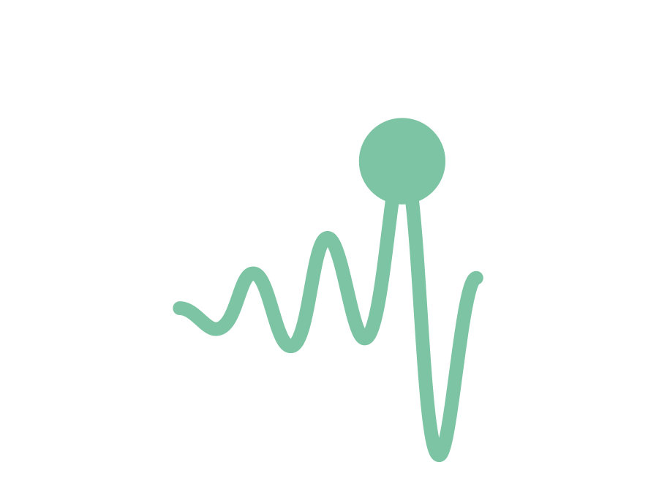

Interacoustics Academy Clinical Diploma
What is it?
Many people asking for “formal” clinical training
University-style module
Diploma awarded on completion
16 lessons
25 hours
Practical sessions
Exam

Slide 4
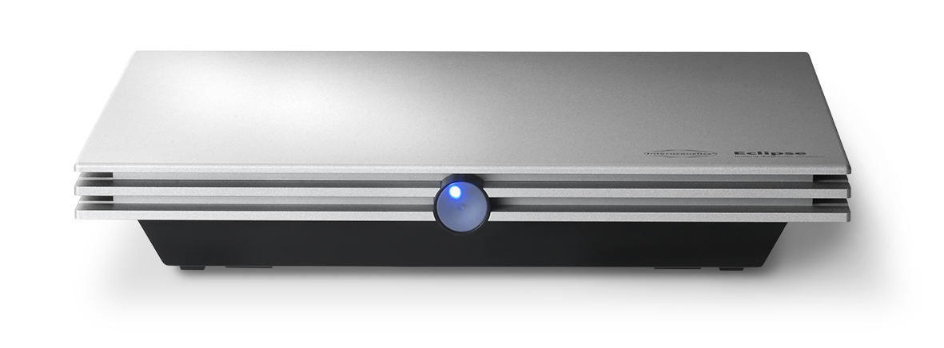
Proud to launch
Interacoustics Academy Clinical Diploma:
Newborn Hearing Assessment

Slide 5
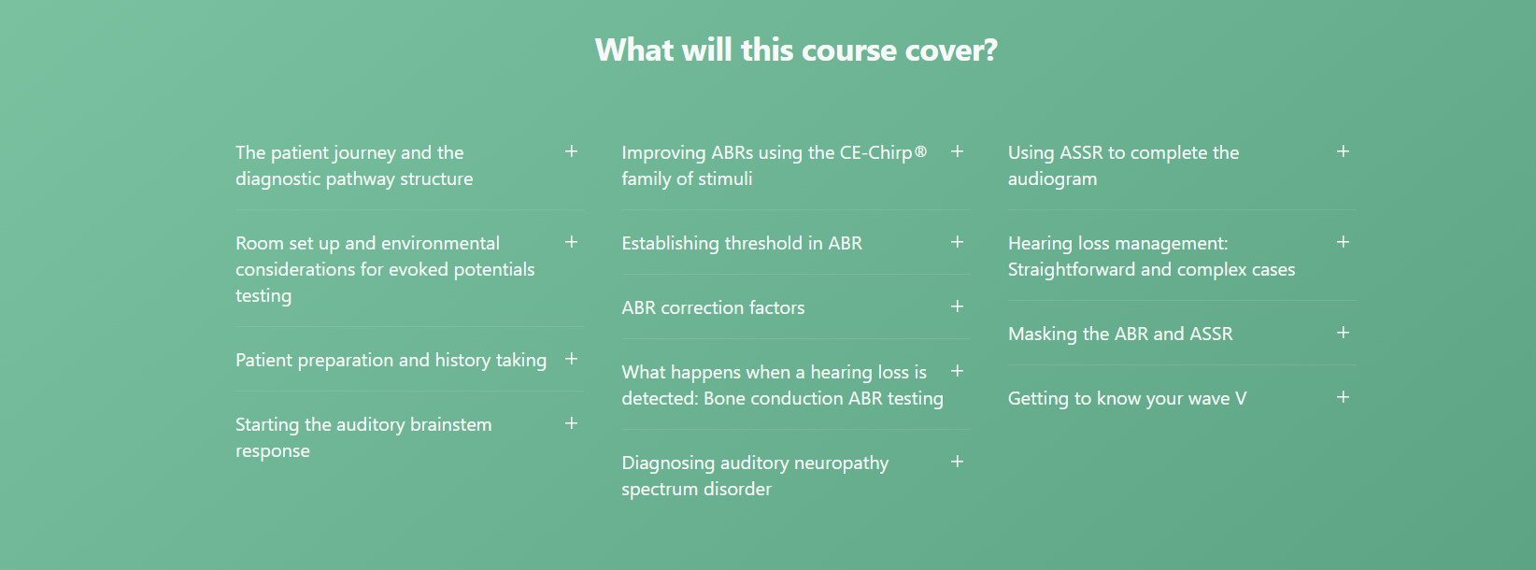
Interacoustics Academy Clinical Diploma:
Newborn Hearing Assessment

Slide 6
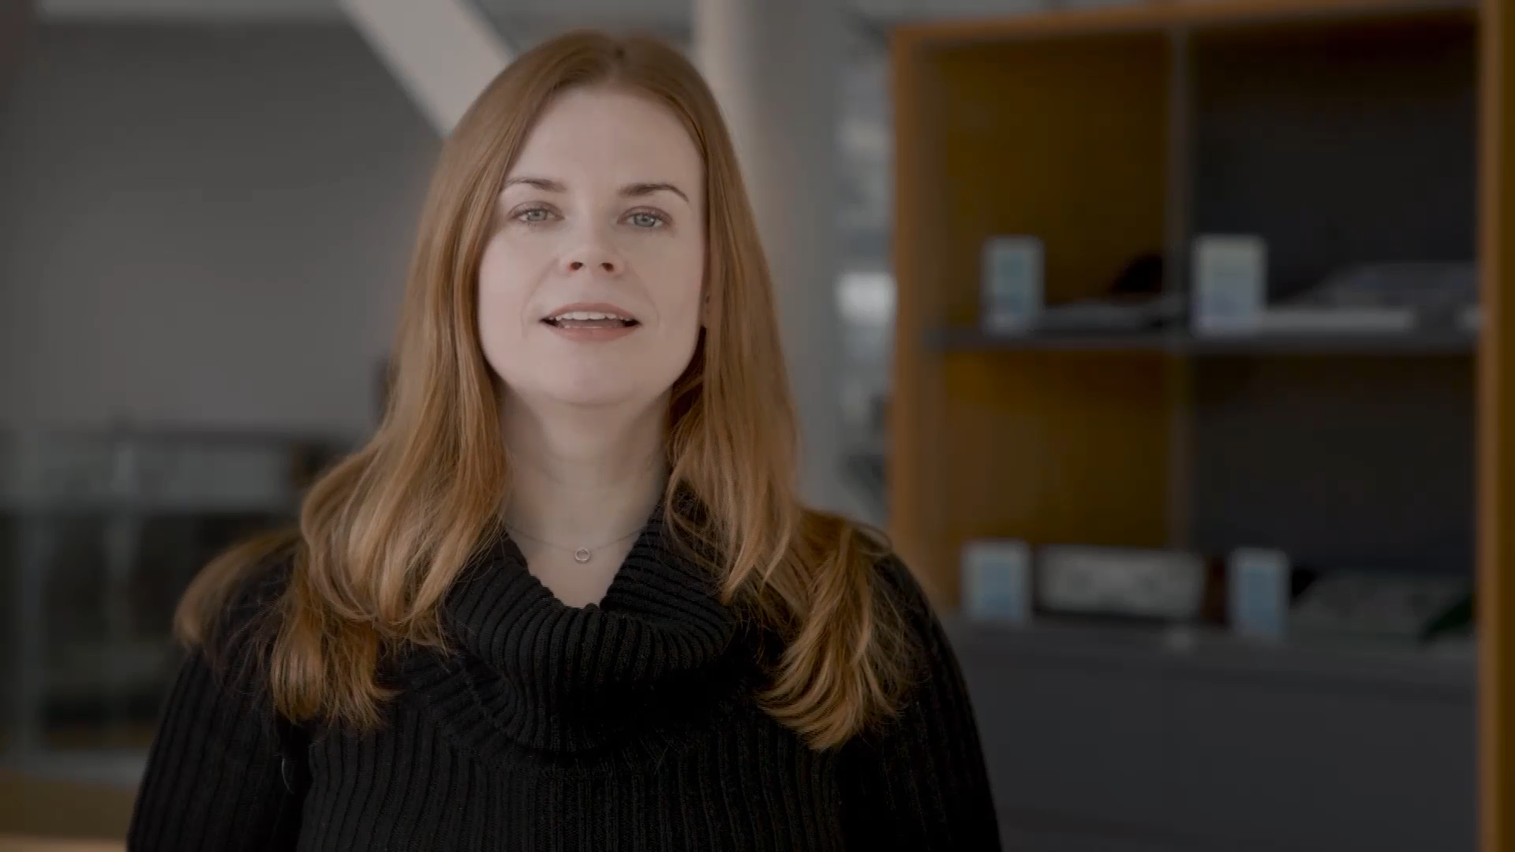

Slide 7
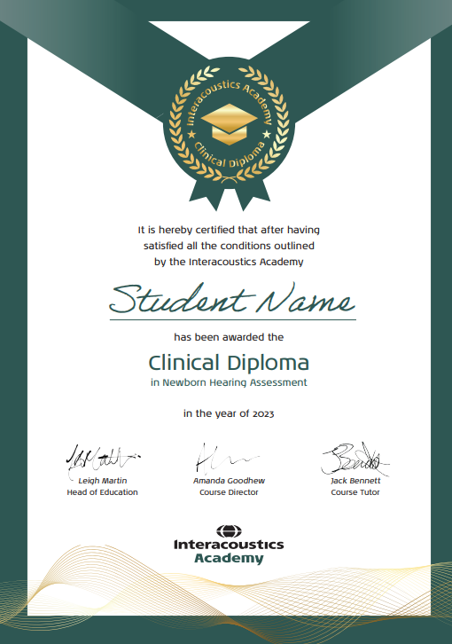
Once completed student receives:
Posted hard diploma
Access to all 12 week courses which are currently not published on the website

Slide 8
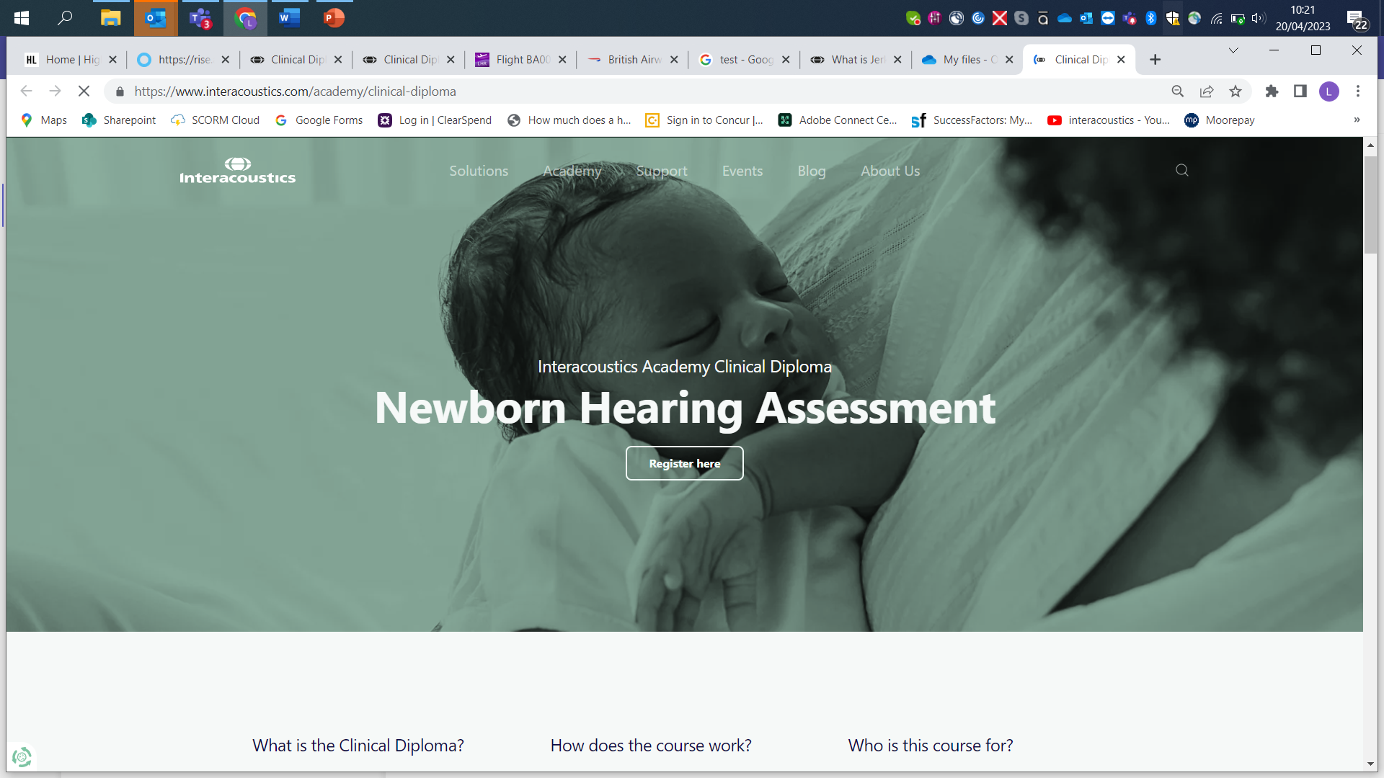
Web page demonstration

Slide 9

Questions

