Slide 1

Interacoustics Academy Clinical Diploma
Launch Presentation & Concept

Slide 2
Interacoustics Academy Clinical Diploma
Launch Presentation & Concept
What is an Interacoustics Academy Clinical Diploma ?
How you can use this tool to support sales, knowledge and training in your markets ?
How to order the diploma ?
How your customers can access the diploma ?
Case studies / business models

Slide 3



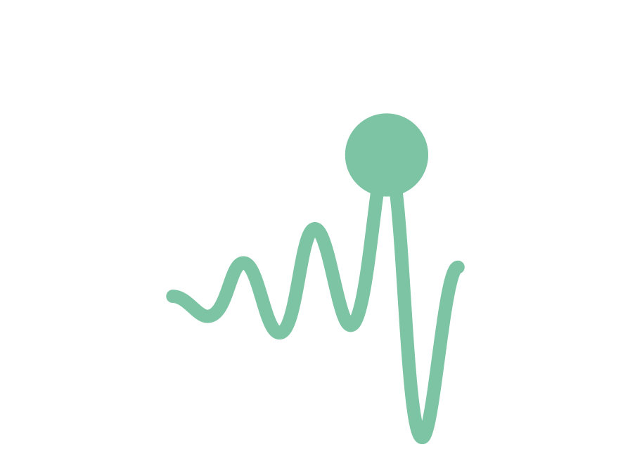

Interacoustics Academy Clinical Diploma
What is it?
Many markets asking for “formal” clinical training
University-style module
Diploma awarded on completion
16 lessons
25 hours
Practical sessions
Exam

Slide 4

Awareness
Consideration
Purchase
Retention
Advocacy
Interacoustics Academy Clinical Diploma
Supporting sales, knowledge and clinical training in your markets
Pre-sales support > Post-sales support
Showcase IA knowledge and expertise
Differentiate IA from the rest & upselling
Ensure users use the device properly
Notes:
Emphasise that this is clinical training, not product/install/set up training – this will still be required

Slide 5
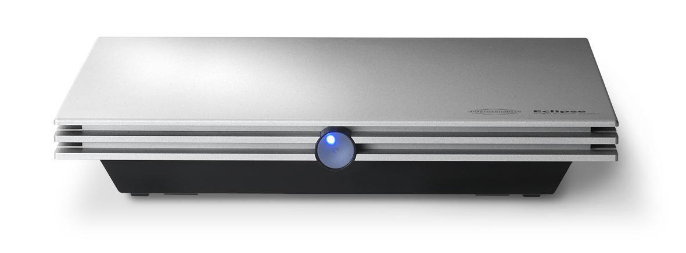
Proud to launch
Interacoustics Academy Clinical Diploma:
Newborn Hearing Assessment

Slide 6
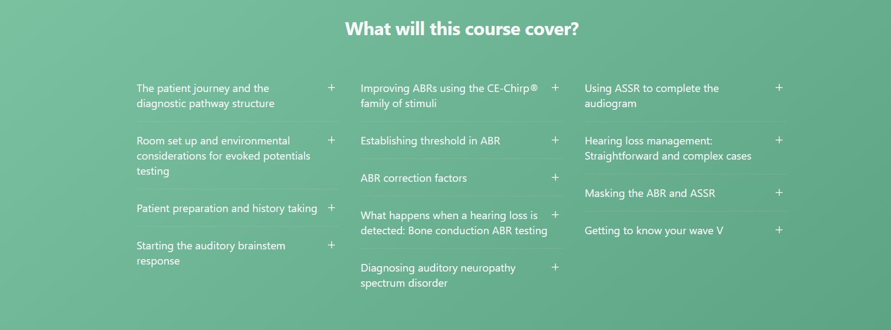
Interacoustics Academy Clinical Diploma:
Newborn Hearing Assessment

Slide 7
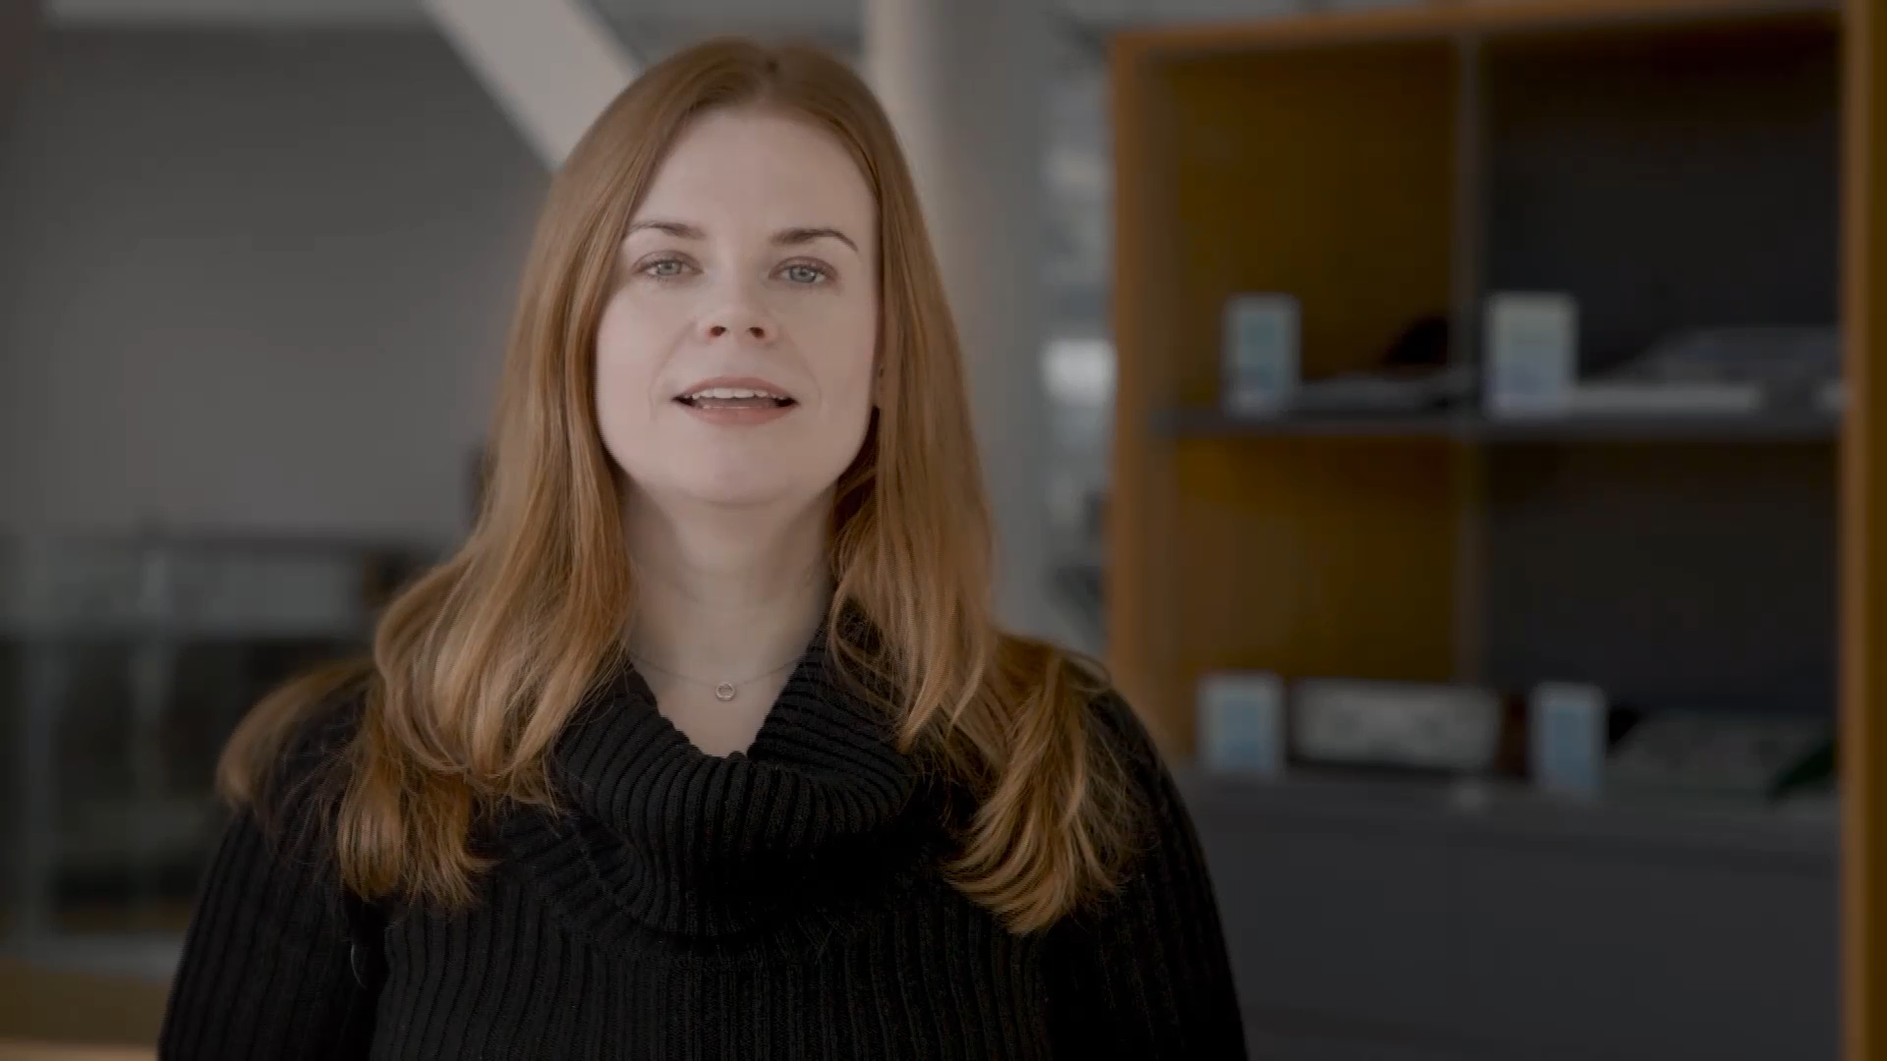

Slide 8
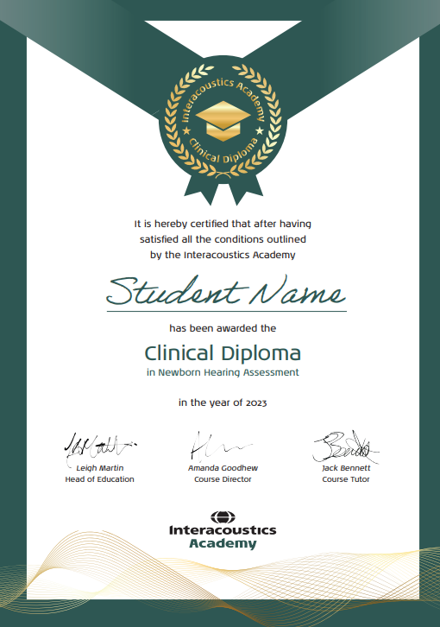
Once completed student receives:
Posted hard diploma
Access to all 12 week courses which are currently not published on the website

Slide 9


Interacoustics Academy Clinical Diploma
How to sign someone up
You sell it directly (most popular)
Price list Item number: 1000755 ABR Clinical Diploma Course
Diploma license cost to you is €200
We recommend that you sell it for €800 (advertised price on website)
Each diploma can only be registered to one individual. If you want 3 people registered, you need to order 3 diplomas
You DO NOT need to provide the email address of the user upon ordering.
Instead we will send you an access certificate and you forward this to your customer

Slide 10
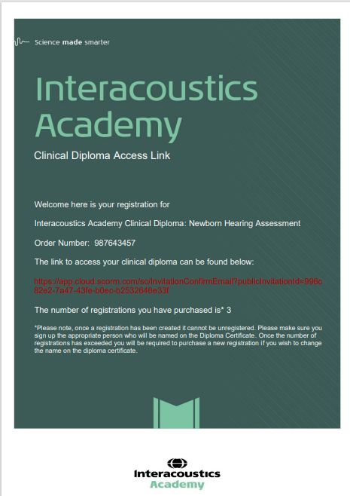
Access certificate
This certificate will be sent by Customer Services to YOUR EMAIL
You then have the pleasure of forwarding this on / printing this out for your customer

Slide 11
Interacoustics Academy Clinical Diploma
How to sign someone up
Diatec / Interacoustics sales company
Distributor
When placing an order, select Diploma in your ERP-system using code #1000755 ABR Clinical Diploma Course
When placing an order, quote code #1000755 ABR Clinical Diploma Course
Access Certificate will be issued and sent to email address
Diploma representative
We recommend you assign someone in your market to manage diploma registrations. I will send around an editable excel sheet. Please enter name of who will be responsible for diploma in your country
Access Certificate will be sent to email used to make the order unless specified otherwise

Slide 12
Interacoustics Academy Clinical Diploma
Order diploma = 3 using code #1000755 ABR Clinical Diploma Course
You are charged 3 x 200 euro
= 600 euro
We recommend you charge 3 x 800 = 2400 euro to customer
Customer services will email you an access certificate with 1 hyperlink which has 3 registrations programmed into to
You share the certificate with the customer
How to sign someone up
Example of ordering 3 diplomas

Slide 13
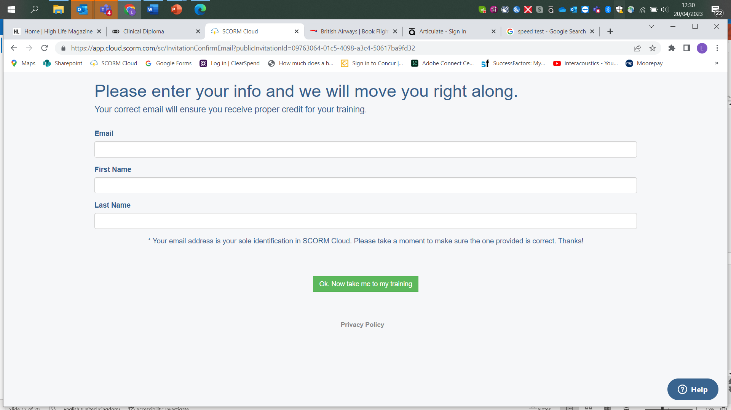
Clicking the link
The link will take the user to this page
The user then inputs the name and email address of the person who will be awarded the diploma.
The link will only work for number of licenses purchased
e.g. 3 licenses = 3 people to get access. The 4th will be declined

Slide 14
Interacoustics Academy Clinical Diploma
How to sign someone up
Direct online Access (more for advertising)
A dedicated webpage has been set up this is mainly for information and to show the value of the diploma to be €800
End users can order a diploma direct if they have a credit card.
However, Purchase orders / group discounts will be directed to contact “their local Interacoustics representative” (YOU)
Sign ups generated though this method will not generate you any income
We feel we need a direct sign up as all other educational formats online offer this but the idea is that this will generate very few sign ups

Slide 15
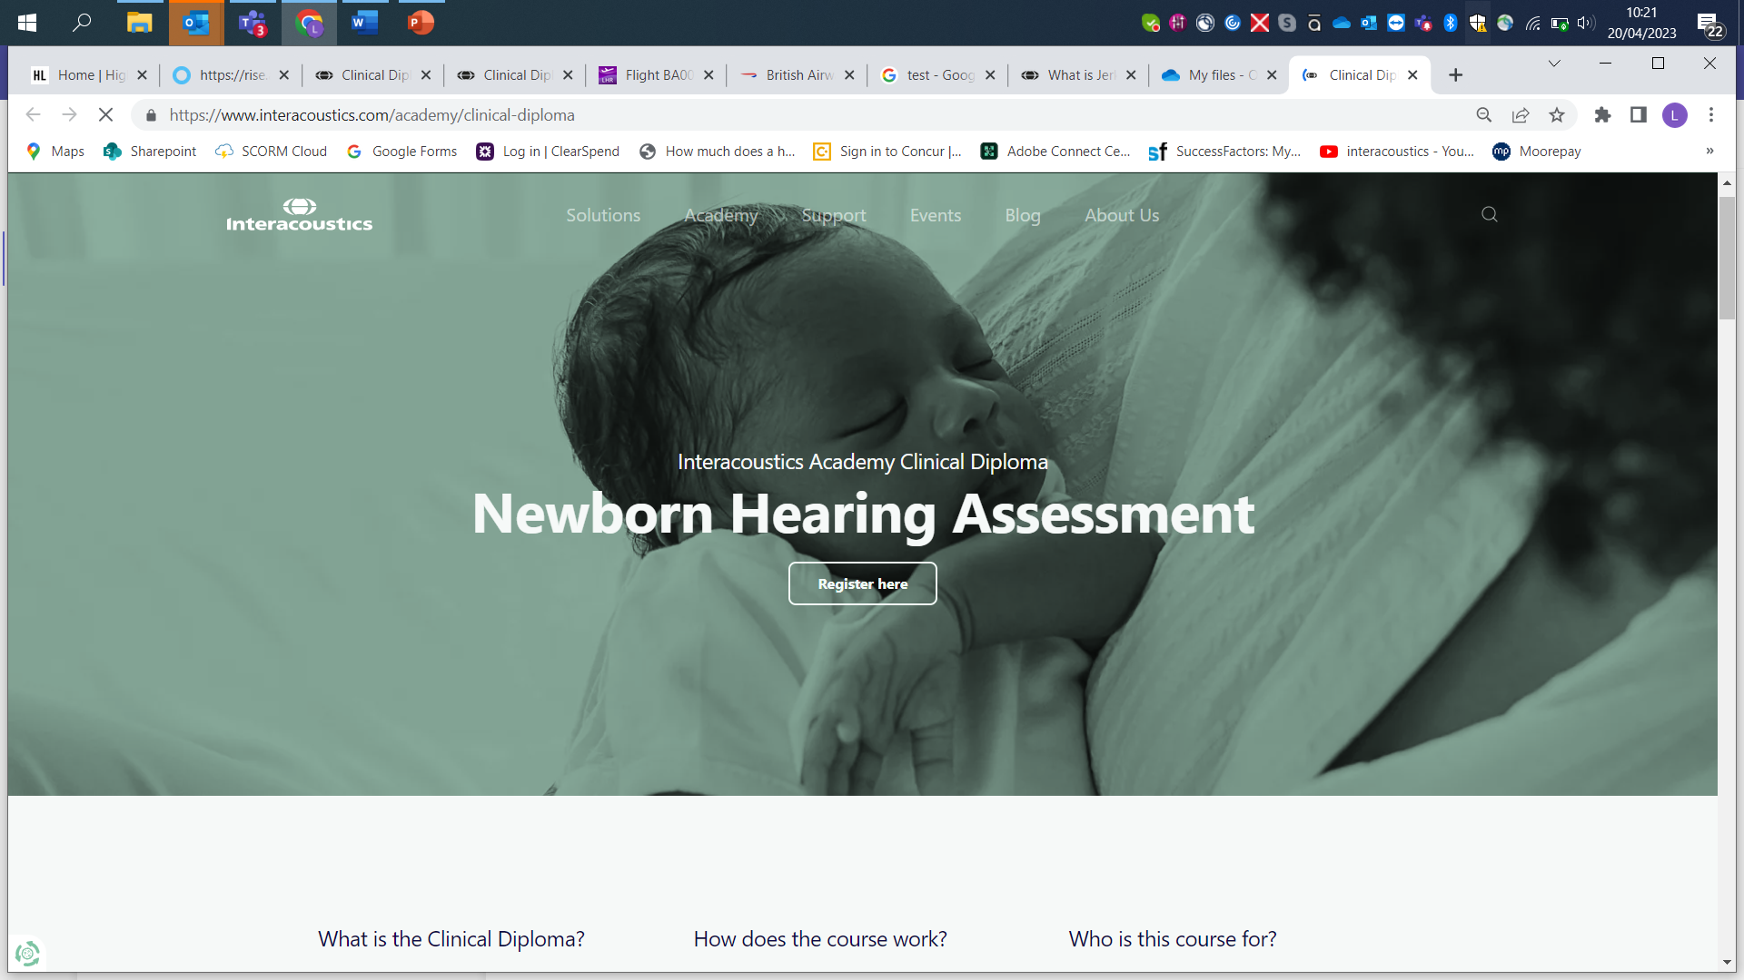
Web page demonstration

Slide 16
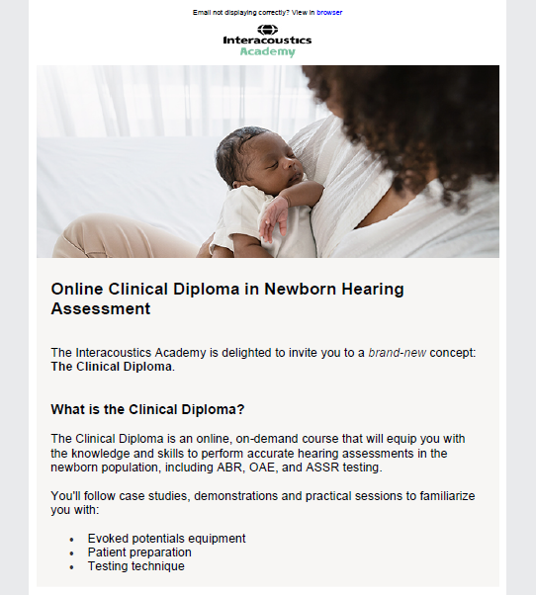

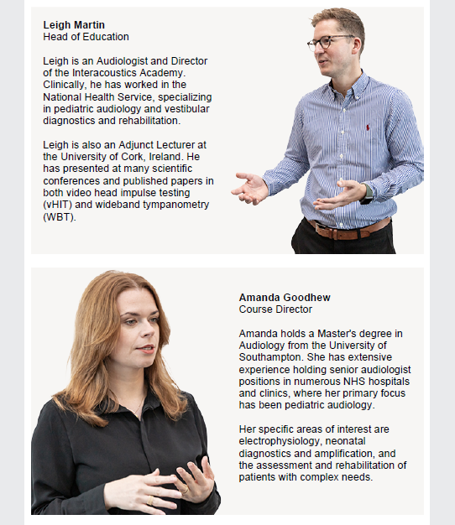
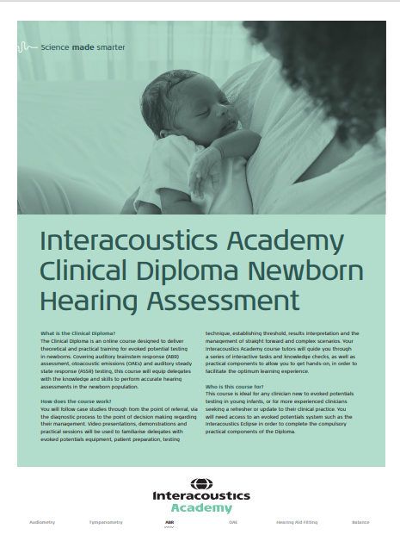
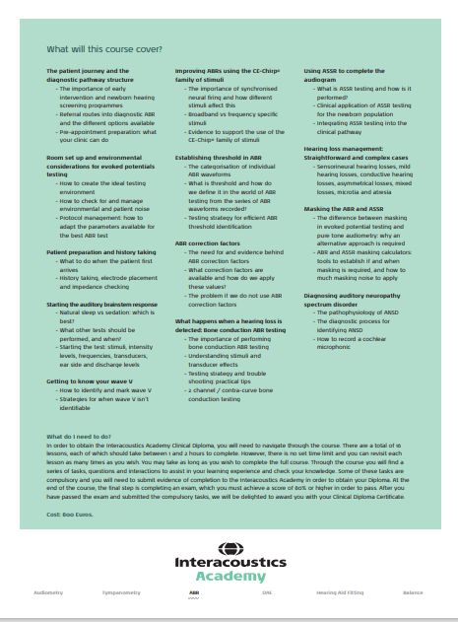
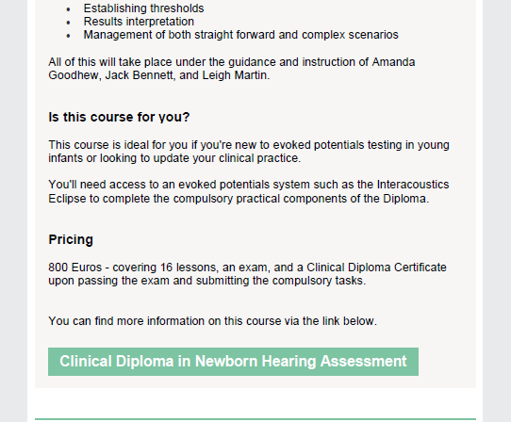
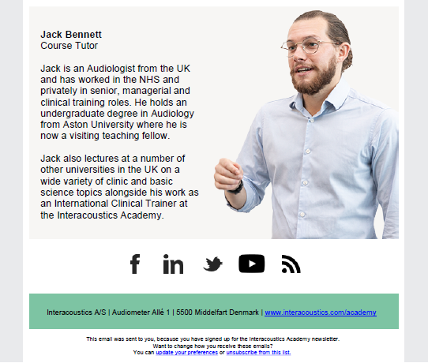
Interacoustics Academy Clinical Diploma
Sales Tools

Slide 17

Interacoustics Academy Clinical Diploma
User cases
Potential Eclipse customer
Buy a licence for yourself and showcase the diploma during the demo process. Just like using a demo device.
OR
Buy customer license prior to sale give access to course to demonstrate the support that is given at Interacoustics.

Slide 18
Interacoustics Academy Clinical Diploma
User cases
New Eclipse purchaser
Sell as a single diploma as part of new Eclipse purchase.
You could also consider making it part of your default Eclipse offering > Some markets doing this
It will save lots of training time moving forward

Slide 19


Interacoustics Academy Clinical Diploma
User cases
Multiple Diplomas wanted
Give 1 diploma away and then sell multiple additions on Eclipse sales
OR
Give bulk discount to multiple diploma purchases

Slide 20
Interacoustics Academy Clinical Diploma
User cases
Existing Eclipse customer
Use the diploma in the upgrade process.
Thinking about CE-Chirp® or ASSR
Buy the software upgrade and price the diploma in to the upgrade

Slide 21
Interacoustics Academy Clinical Diploma
Diploma Accreditation
Accreditation by professional bodies is done on a country by country basis
We are working with a couple of countries to start this process
If you want to get accreditation in your country please reach out to academy@interacoustics.com

Slide 22

Questions

