Slide 1

Science made smarter
Introduction to Affinity Compact
Presentation for users

Slide 2
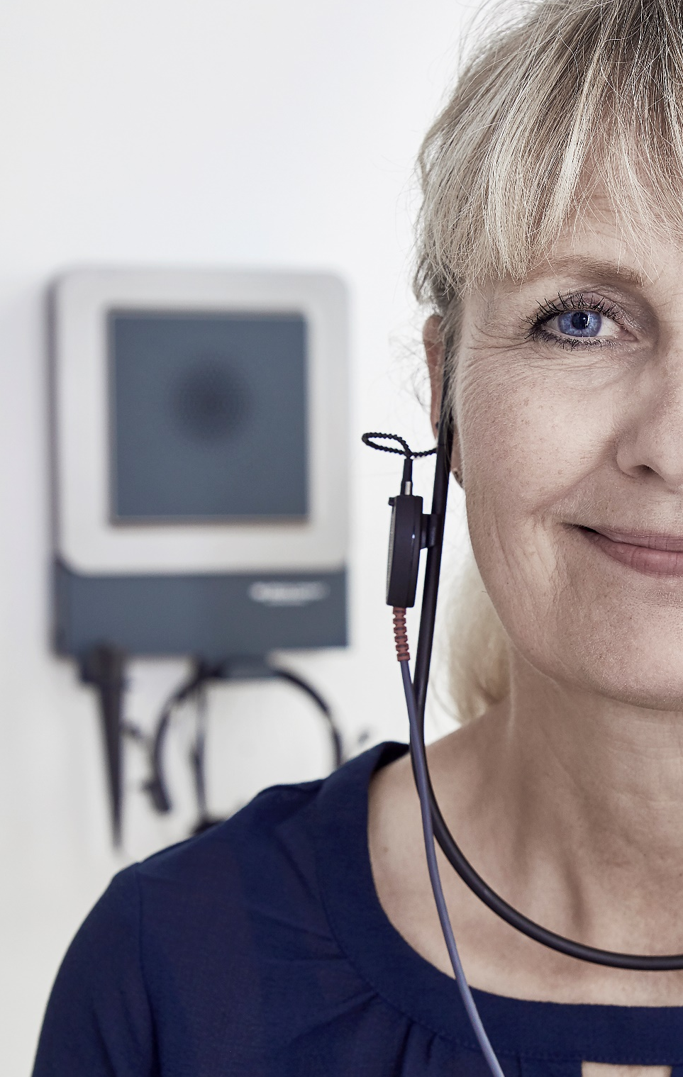

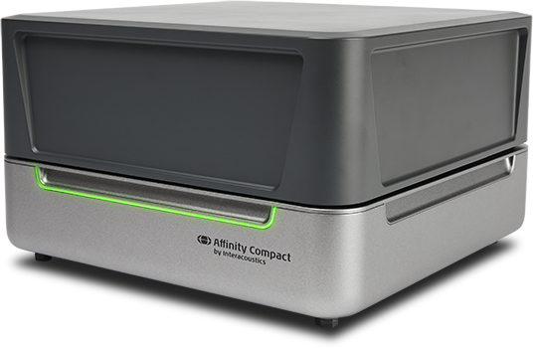
What inspires us
to develop fitting
solutions?
Hearing care
professionals
Hearing aid
users

Slide 3
Moving to the next level with Affintiy Compact
Small footprint
Improved installation options
Transducer storing
Flexible REM Loudspeaker
Portability
Optimized sockets
‘All in one box’ (but modular)
New and modern design
Focus on reliability
User-friendly test box
Integrated power safe
Practical connector box
Easily cleaned
New and optimized REM headset

Slide 4
Appointment flow
First appointment
Fitting appointment
Follow up
Repair
Reassessment

Slide 5

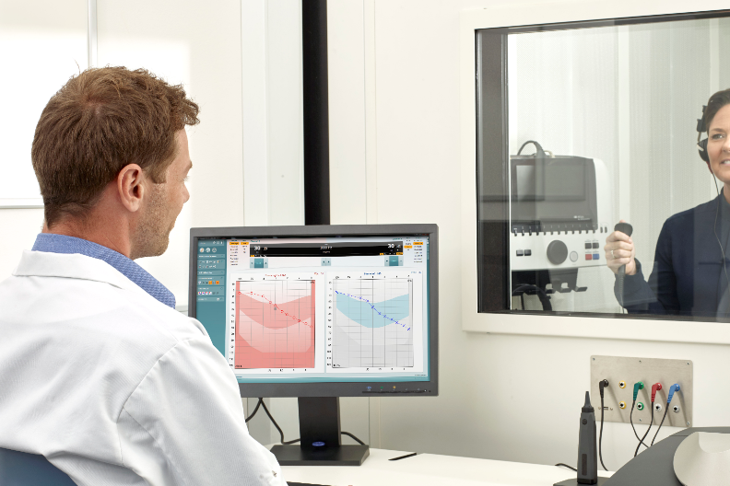
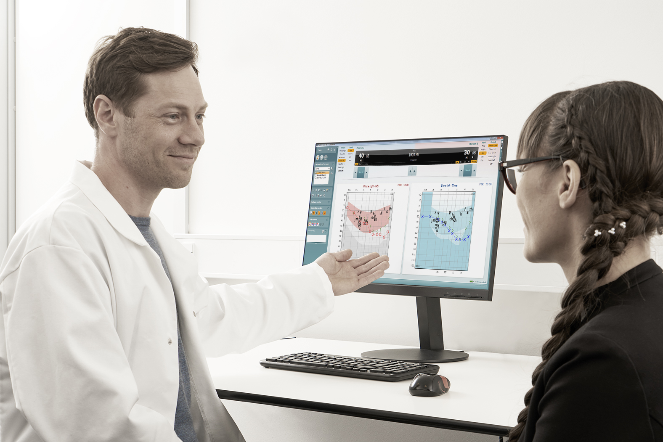
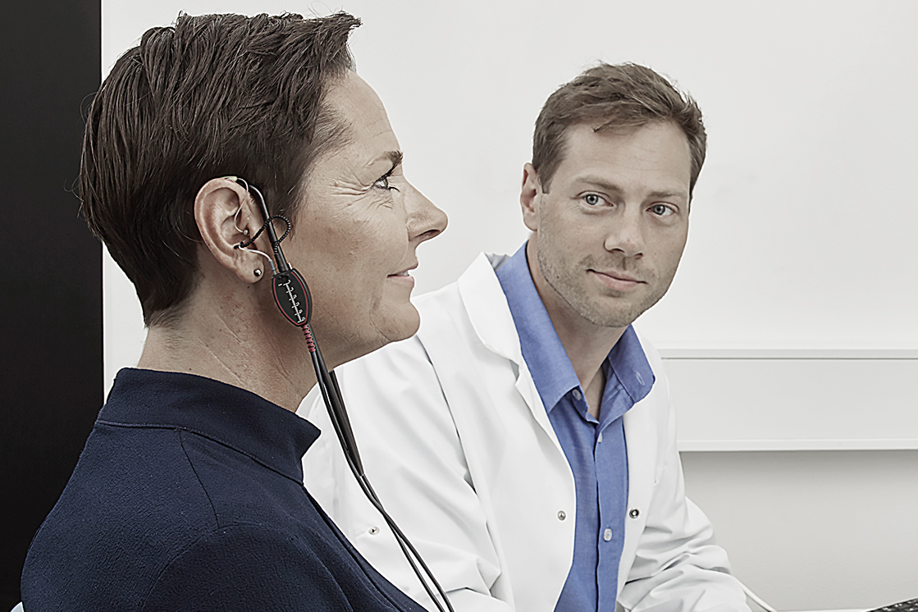
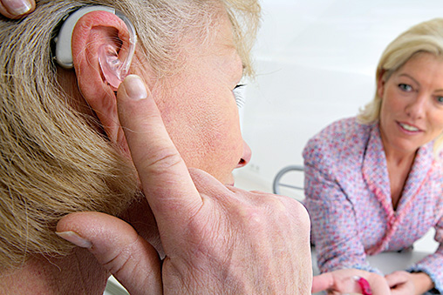
The ideal workflow
Conclusion:
Flexibility and modularity
is key!

Slide 6
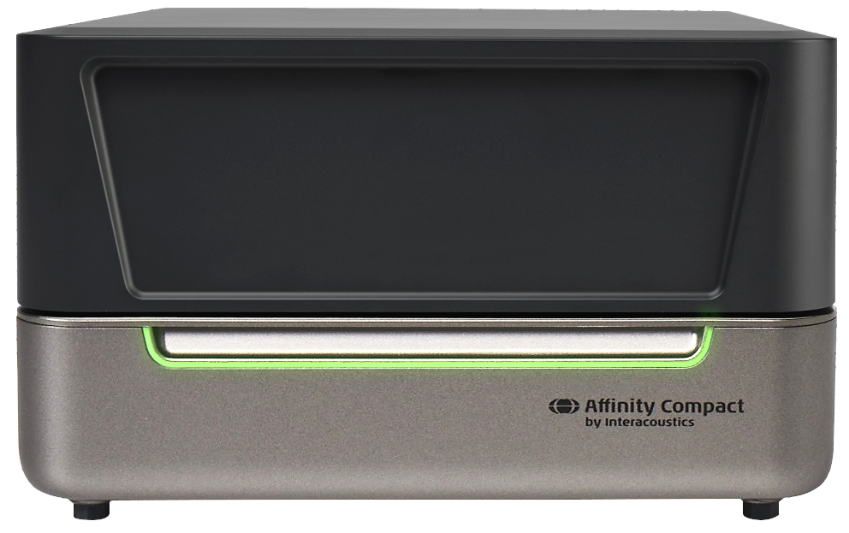
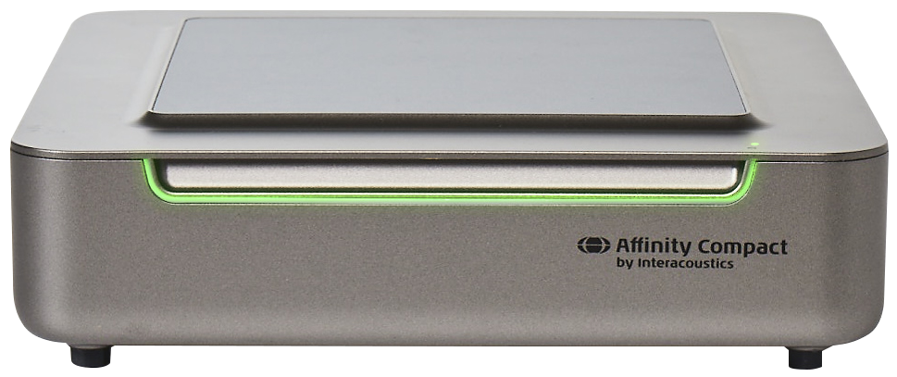
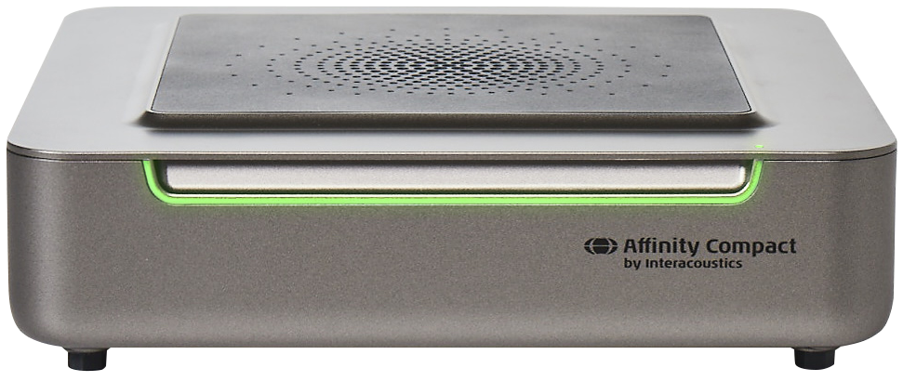
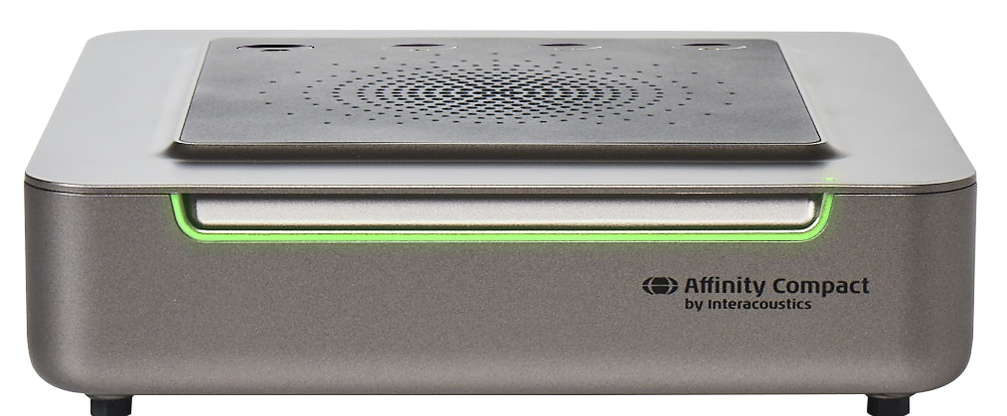
The four versions of Affinity Compact
Version 1
Audiometry and/or REM/visible speech mapping
Version 2
Audiometry and/or REM/visible speech mapping with integrated REM speaker
Version 3
Audiometry and/or REM/visible speech mapping/RECD
Version 4
Audiometry and/or REM/visible speech mapping and/or HIT with enclosed HIT chamber

Slide 7
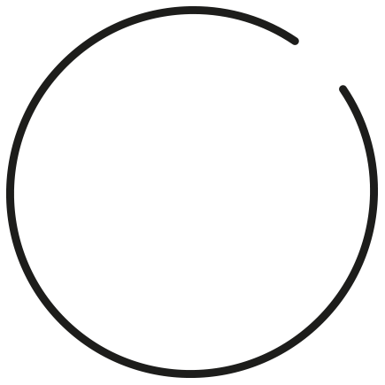
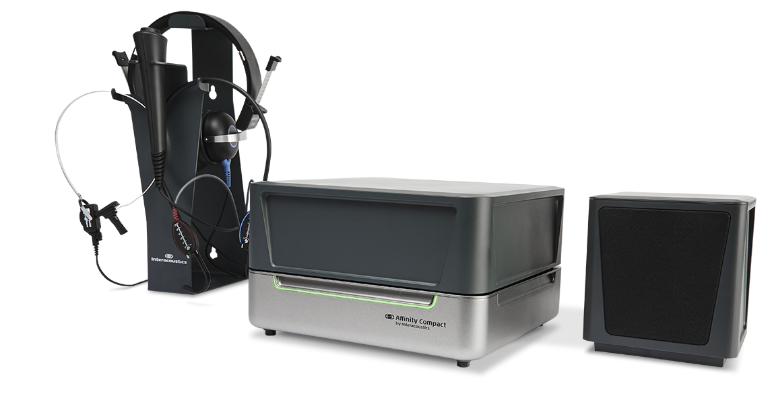
Design
Independently designed with
modularity in focus for flexible
positioning.
‘All-in-one-box’ solution.
With a small footprint and
various mounting solutions,
Affinity Compact presents a
professional appearance
and supports the clean-desk
philosophy.
Design
made
functional

Slide 8
Usability
Software and hardware have been designed to compliment each other to make the workflow simple and quick.
Short learning curve and easy access to the test chamber without hygienic compromises.
Reliability
made
essential

Slide 9
Quality
Solid as a rock:
This system has been tested extensively to provide software and hardware performance you can rely on.
Reliability
made
essential

Slide 10
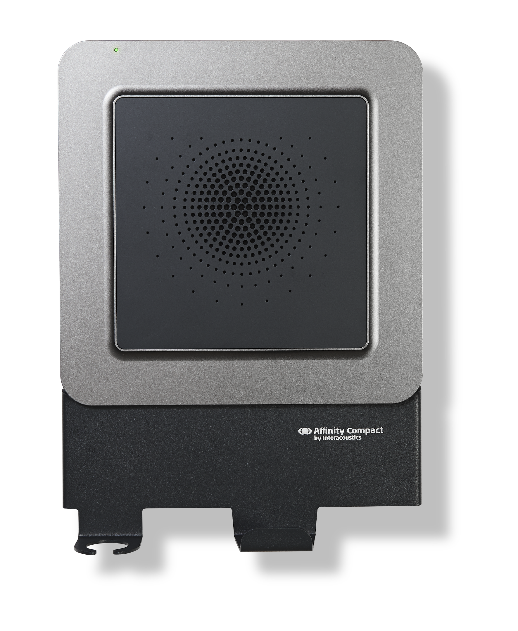
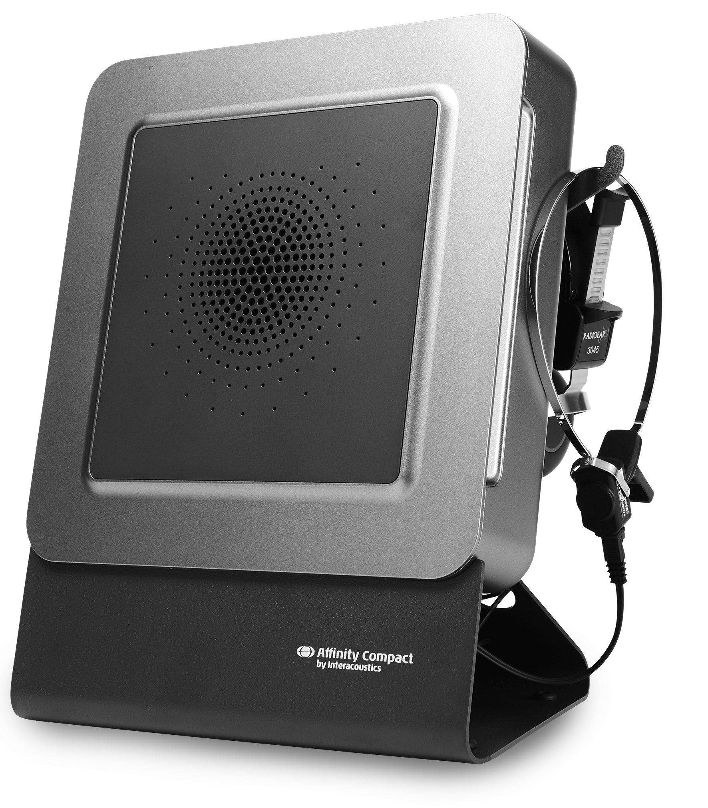
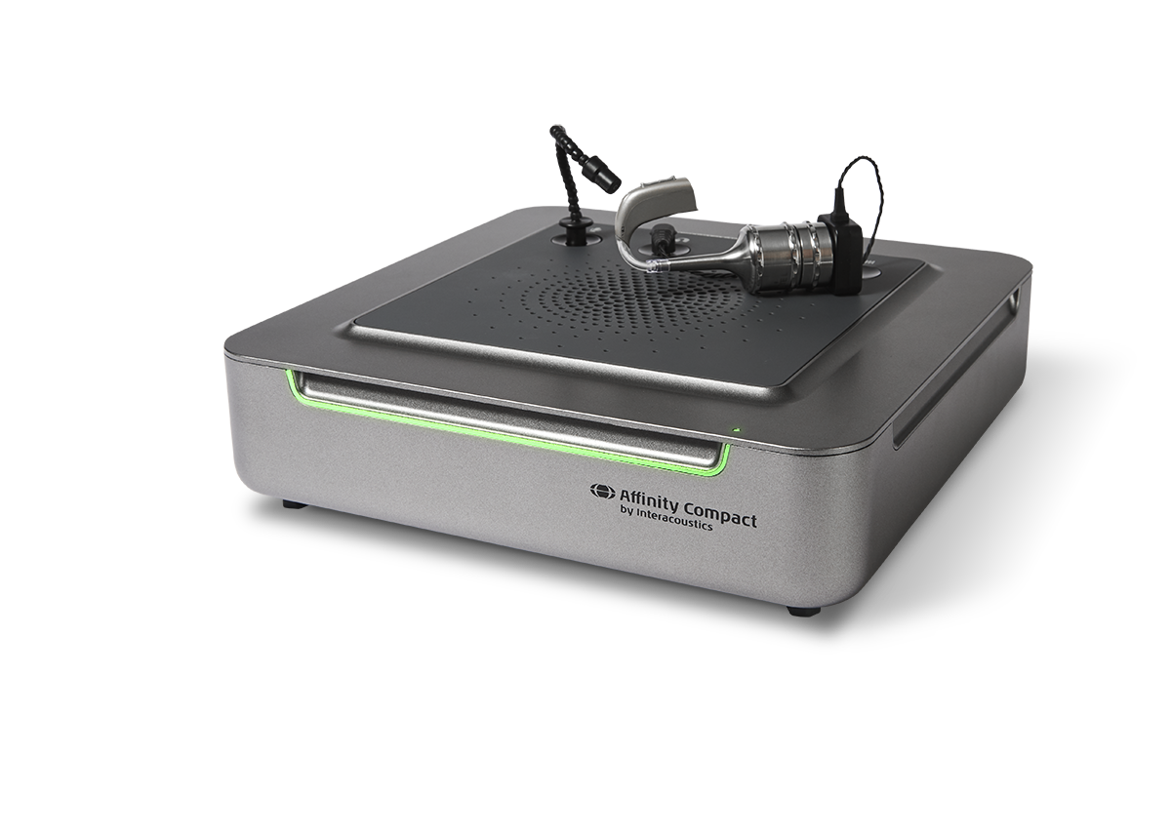
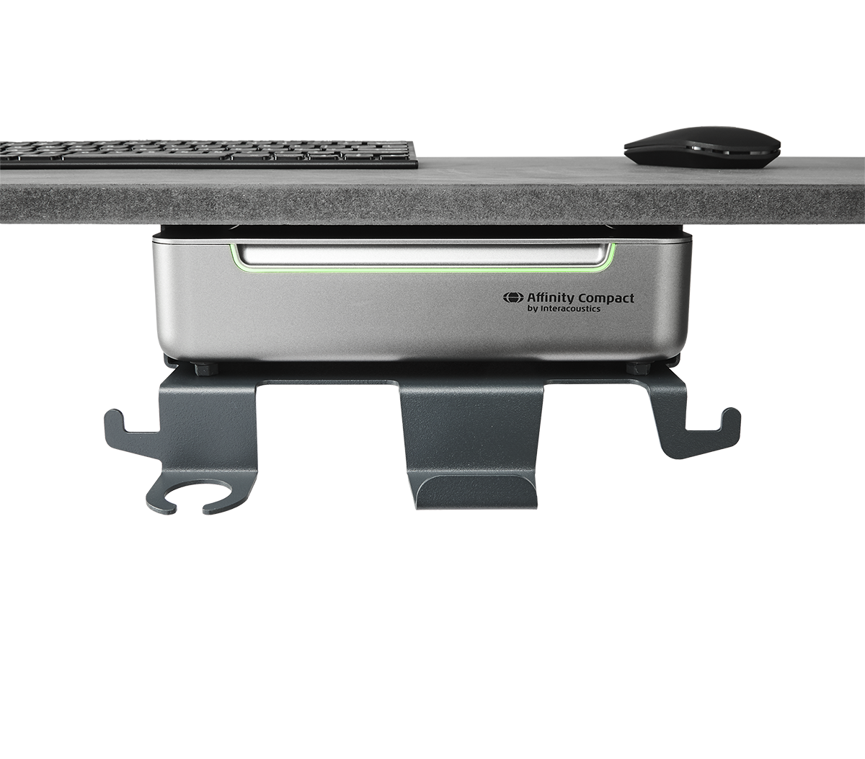
Design made functional
Different mounting possibilities
Built-in REM speaker
Dedicated speaker
All in one box but still flexible
Easy RECD solution
Clean desk philosophy

Slide 11

Does one size fit all?
Made
to fit
your clinic

Slide 12
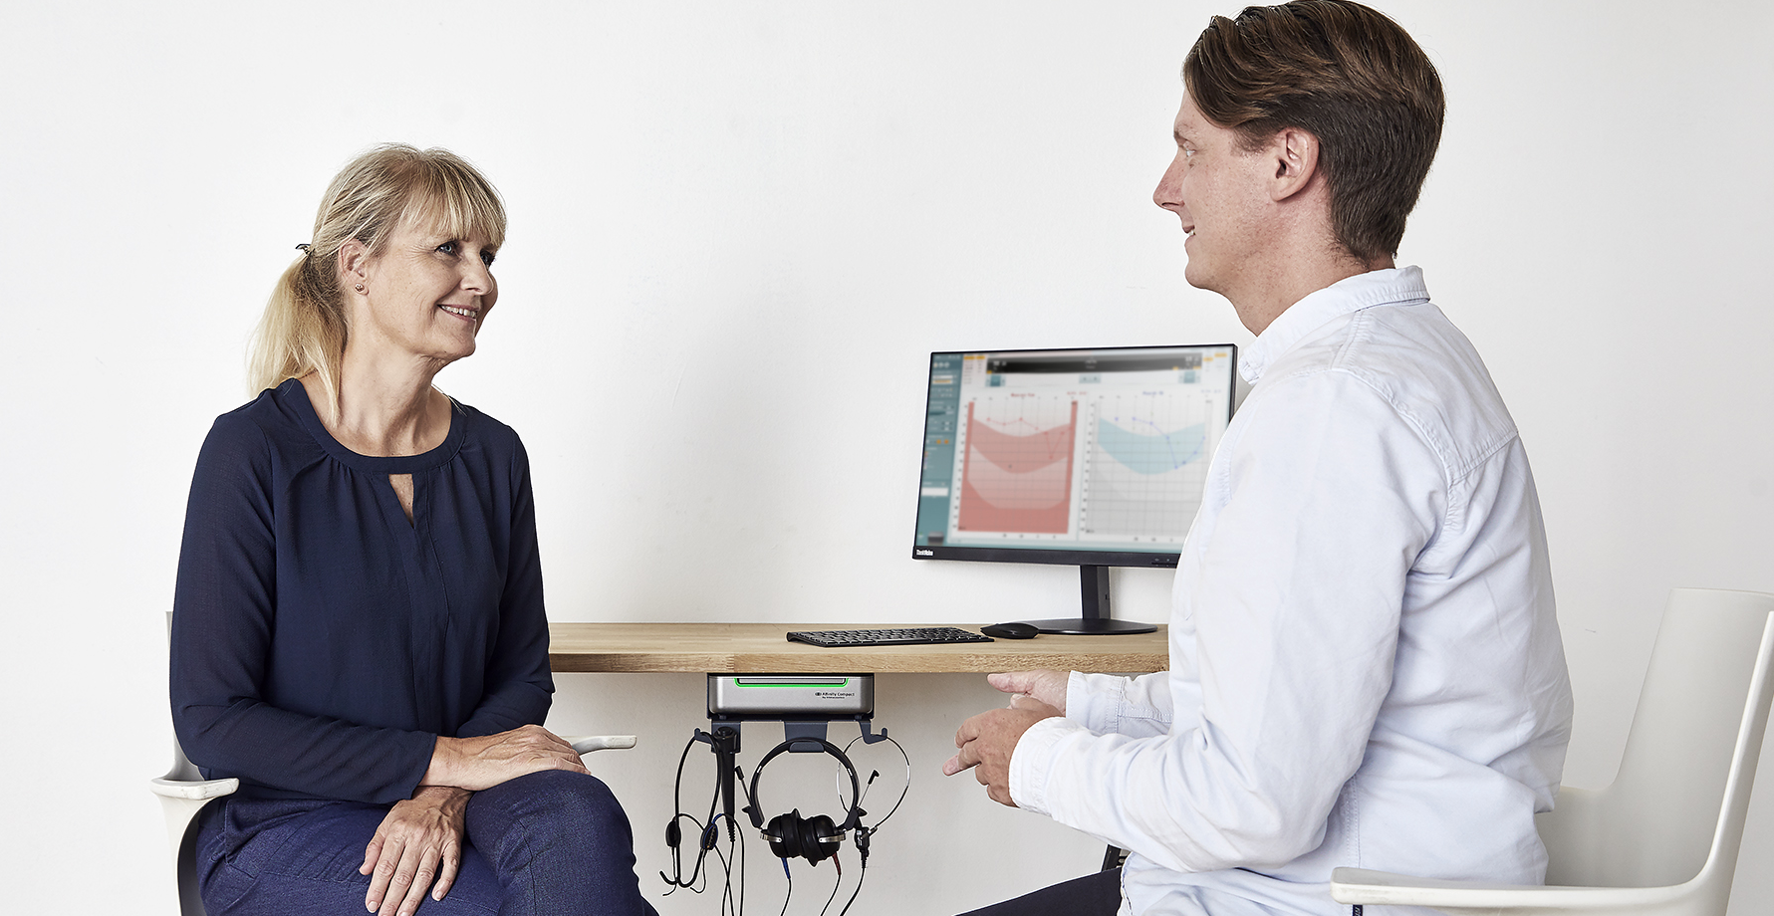
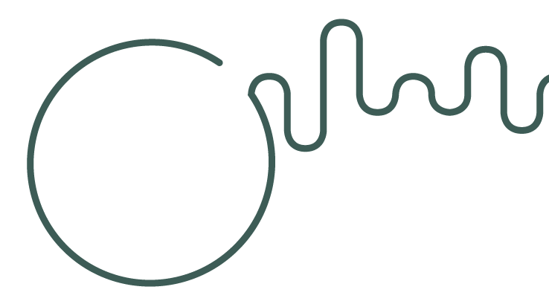
Science made smarter
Clean desk
philosophy

Slide 13
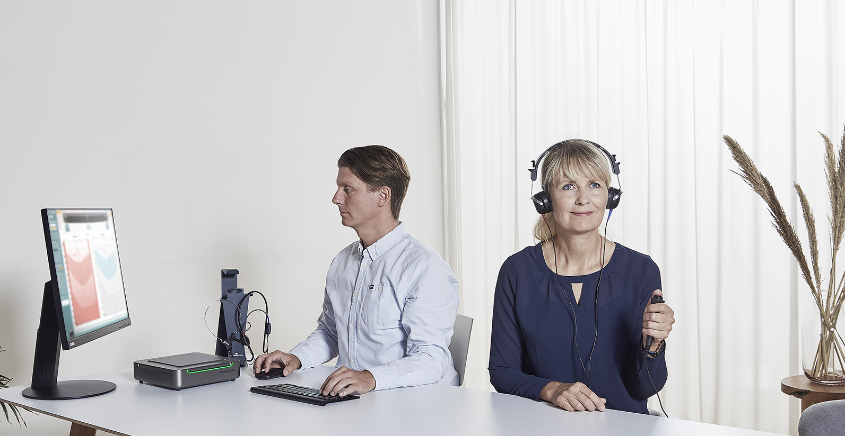
Science made smarter
Clean desk
philosophy

Slide 14
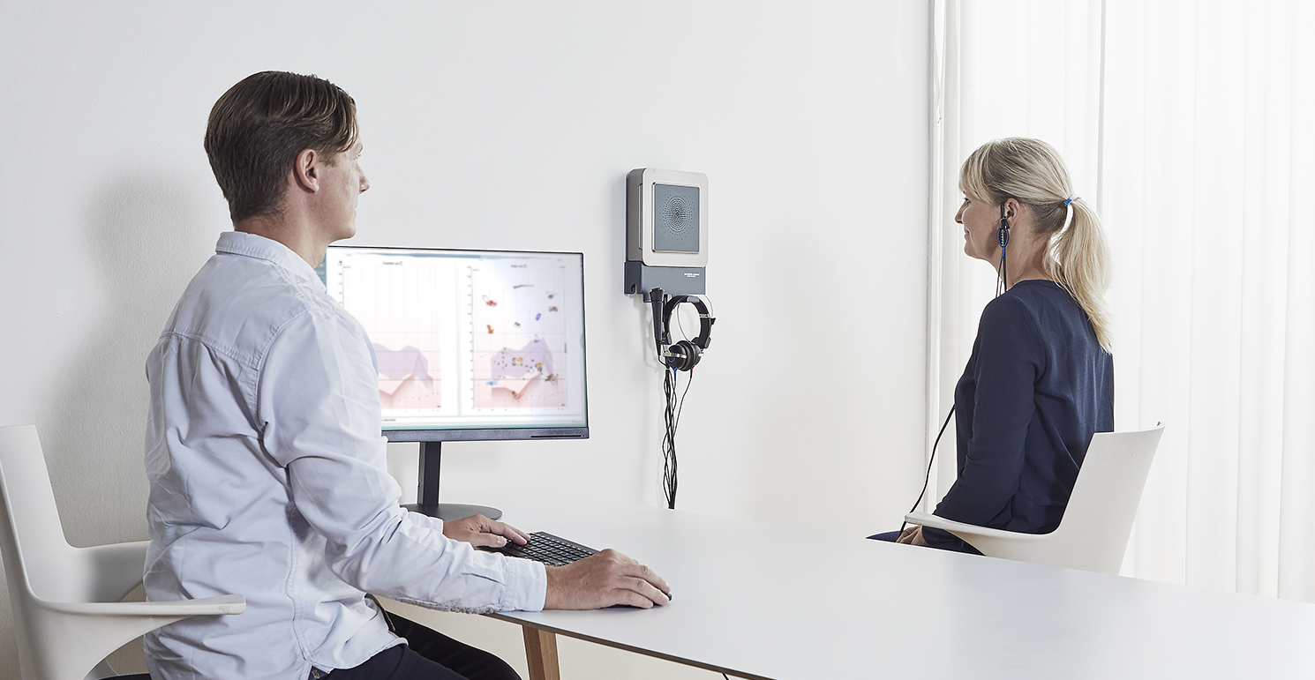
Science made smarter
Your clinic made flexible

Slide 15

Science made smarter
Fitting
made compact

Slide 16
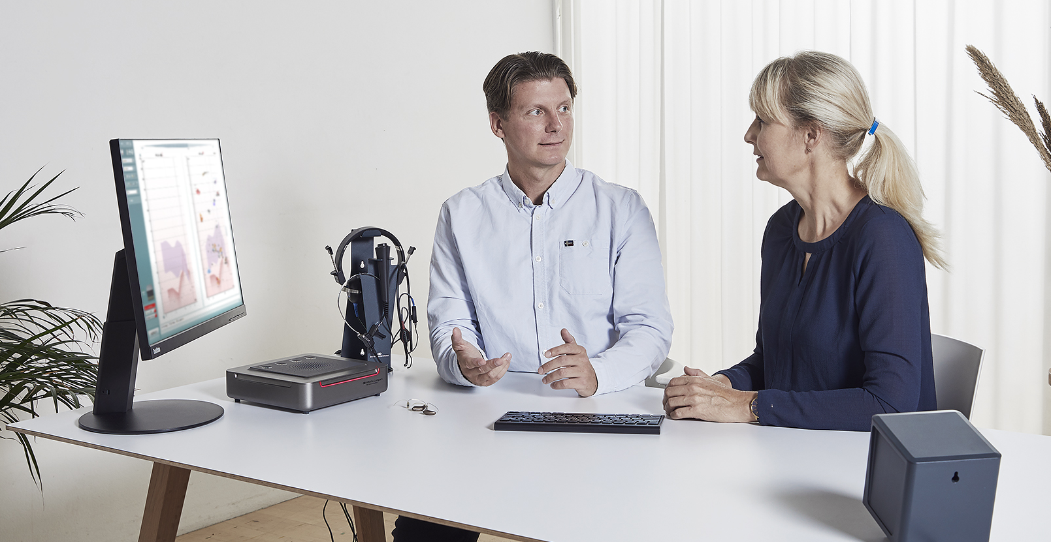
Science made smarter
Pediatrics made easy

Slide 17
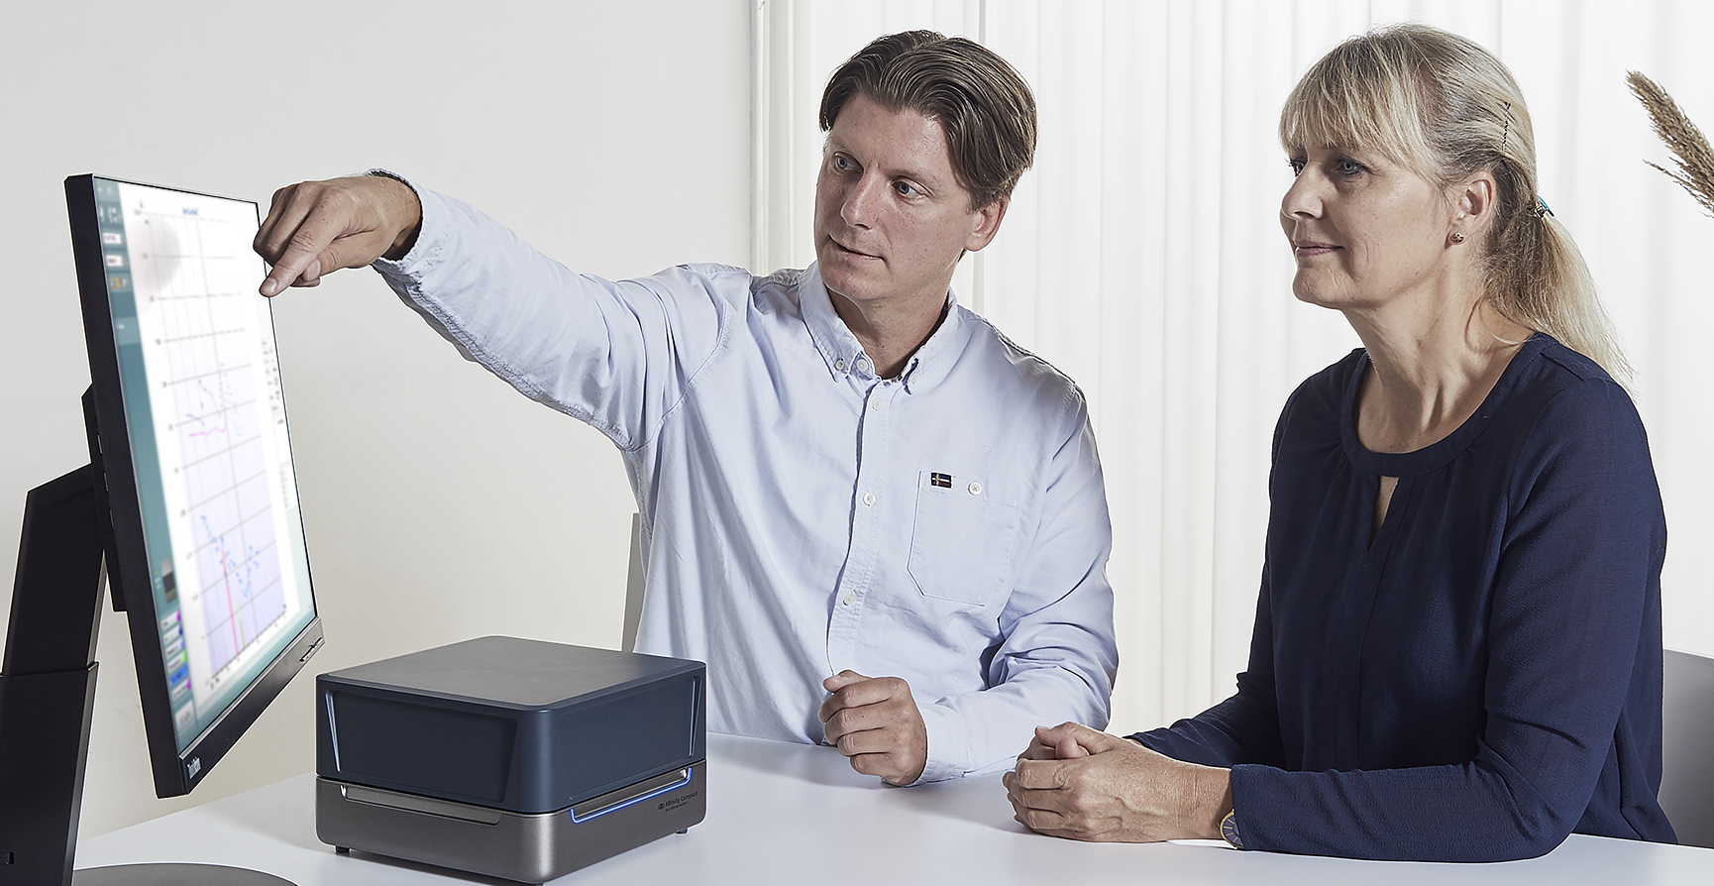
Science made smarter
‘All-in-one-box’
solution

Slide 18
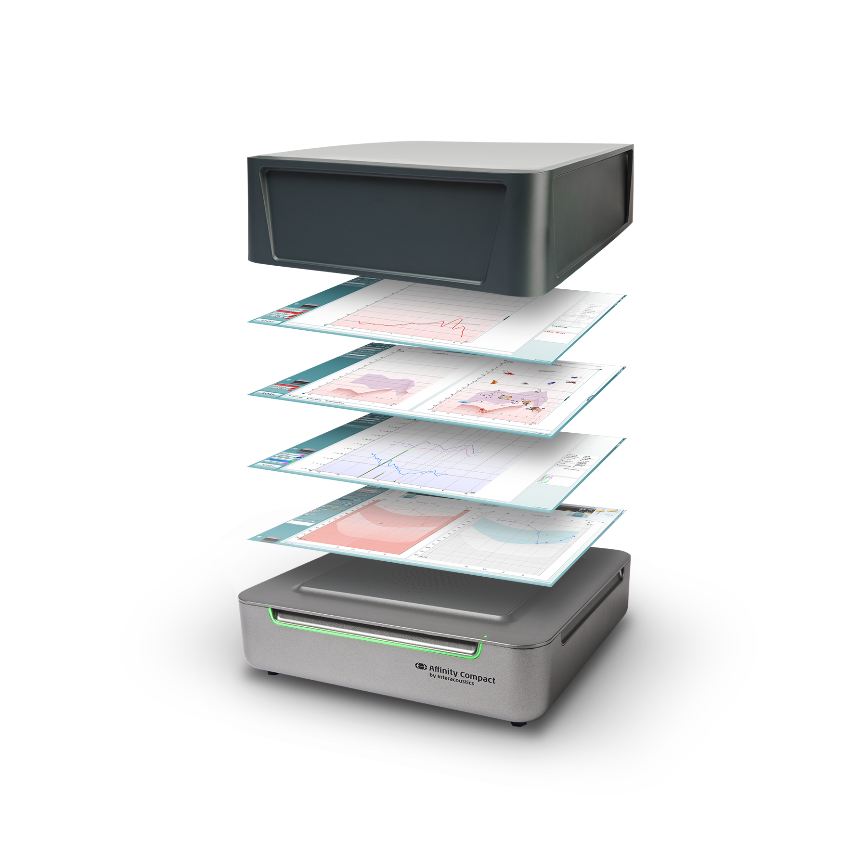
Software
made
human

Slide 19
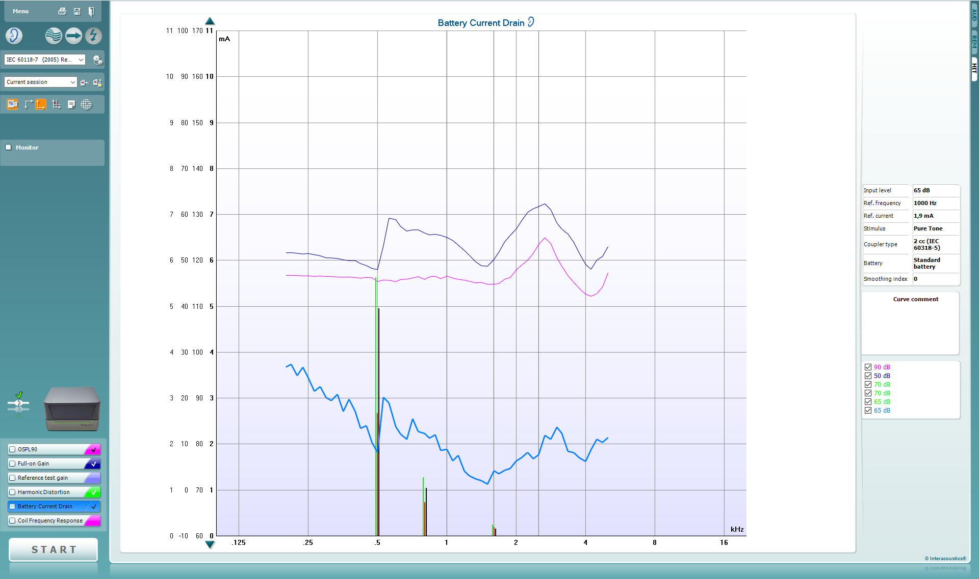
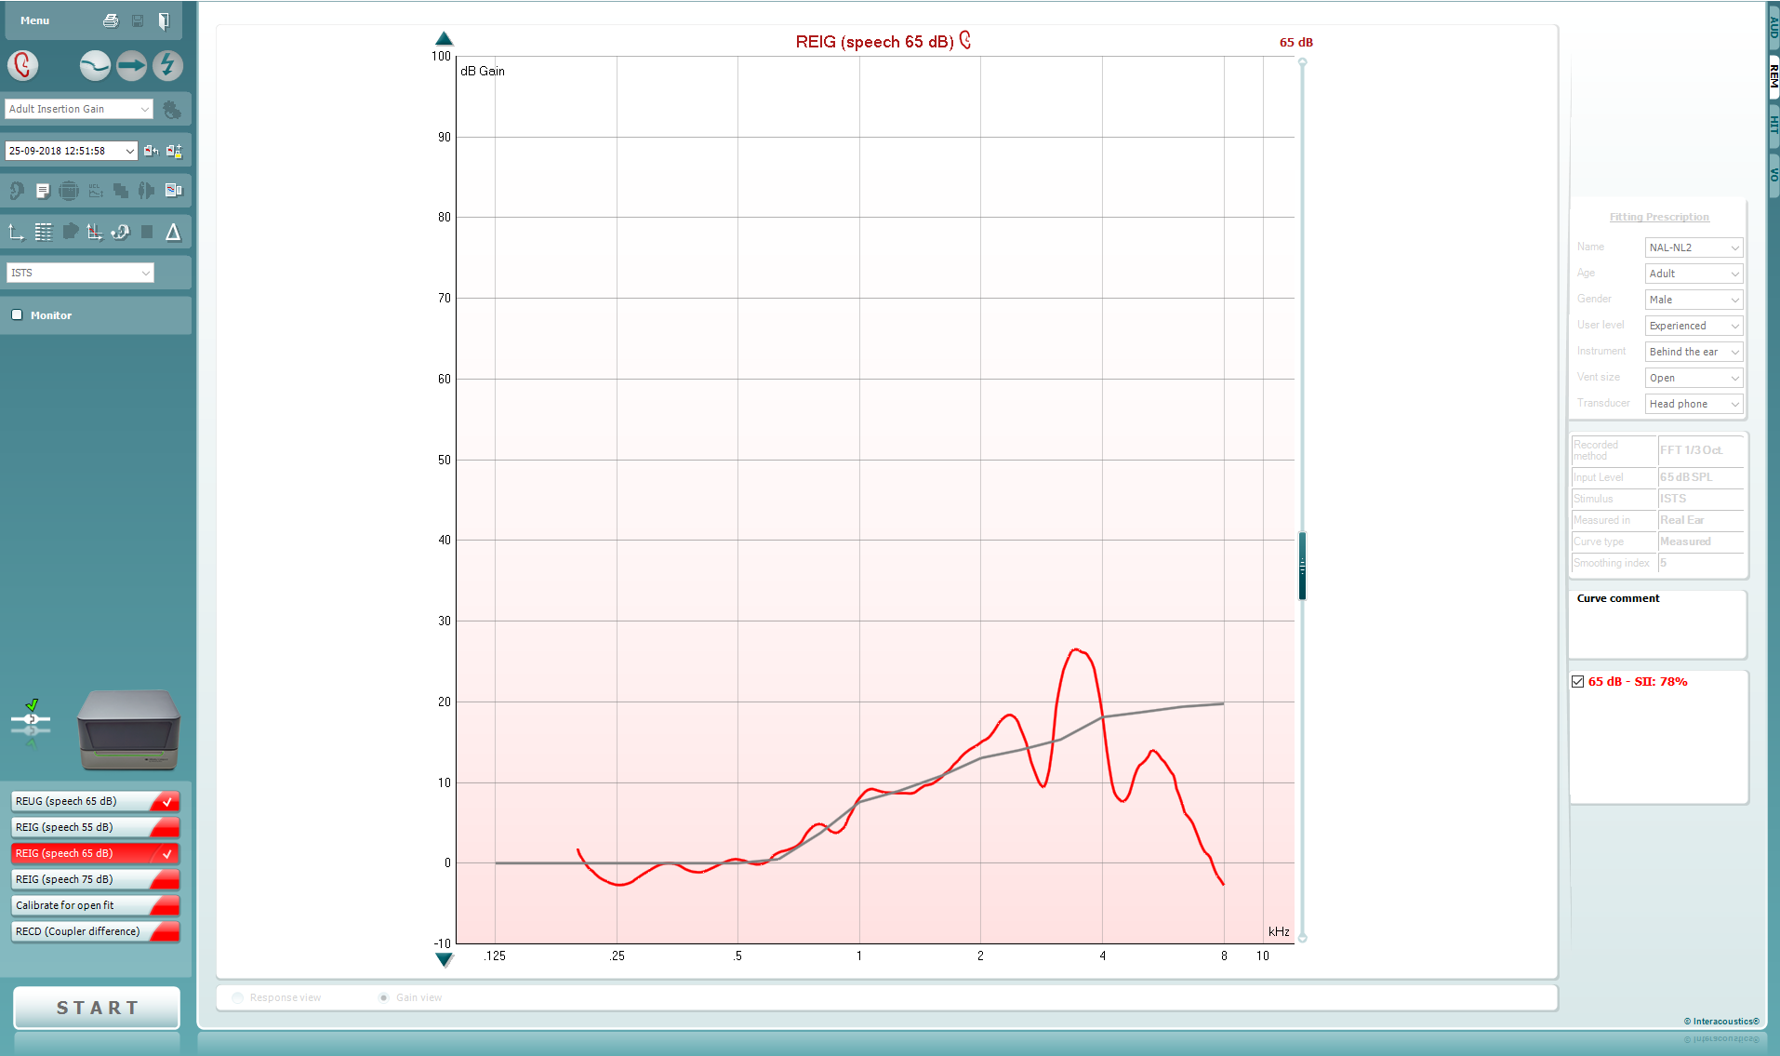
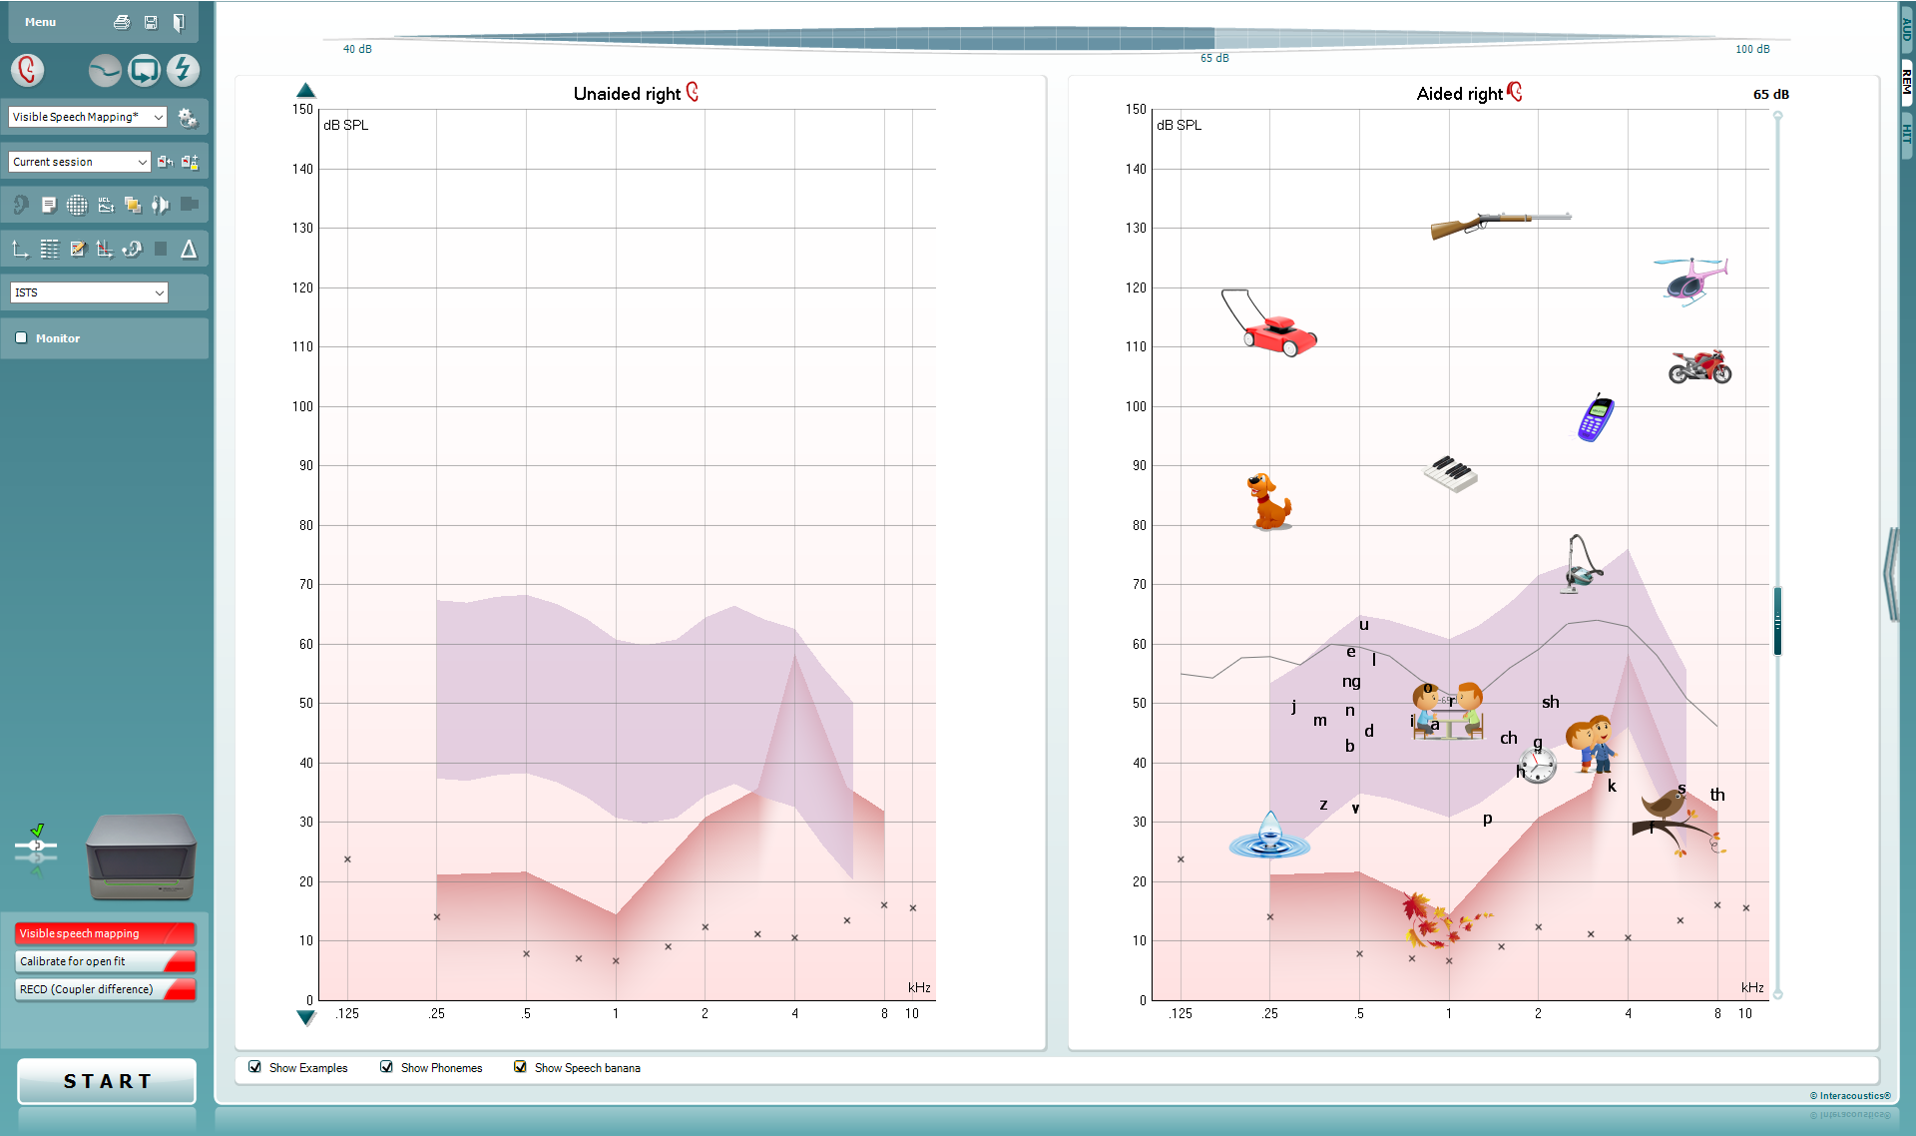
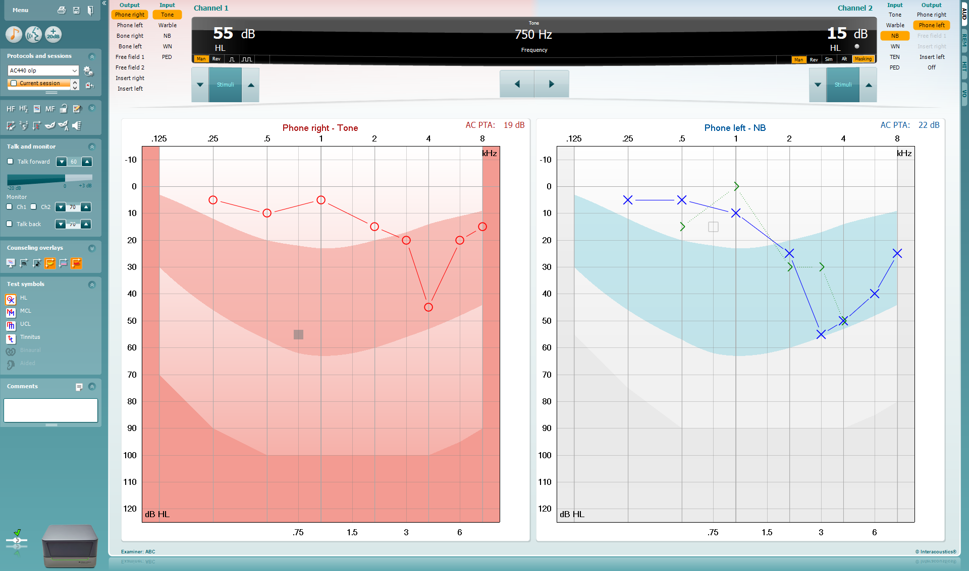
Affinity Suite
ViotTM
Audiometry
REM
Visible speech mapping
HIT
Hearing instrument testing
Real-ear measurement
Visible speech mapping
Audiometry

Slide 20

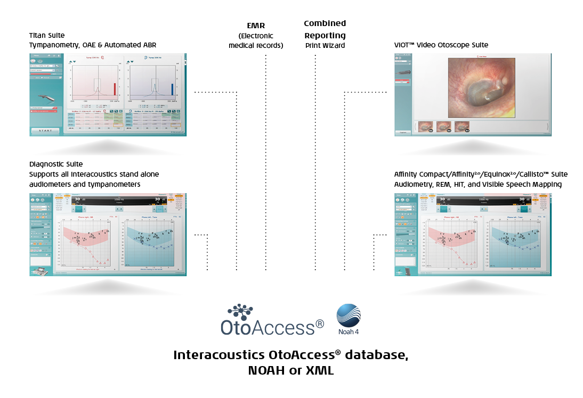
Database integration
Compatible
with Noah and OtoAccess® Database
Through the intuitive and easy to use software, suites can easily be combined and integrated with other Interacoustics instruments.
Quality patient care
Efficient data management
Optimized workflows
Eliminates the complexity of data management
Effective integration with diagnostics equipment

Slide 21
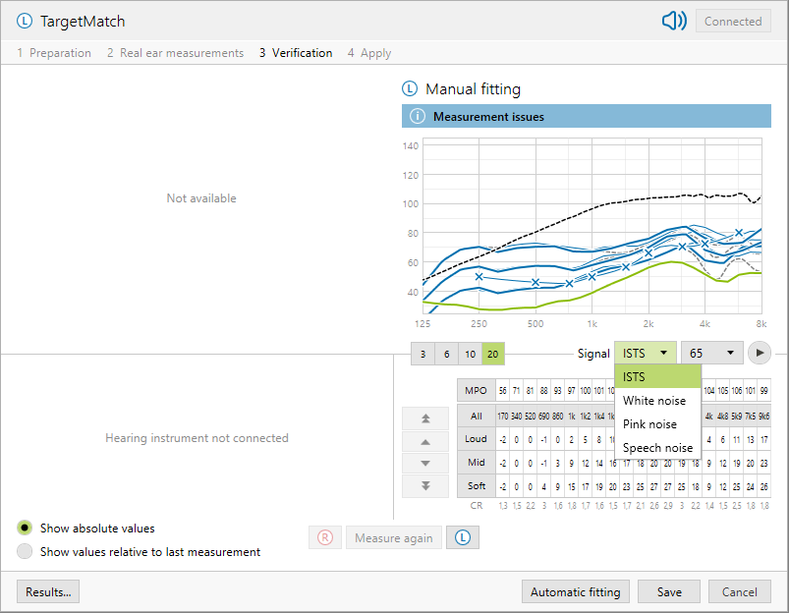
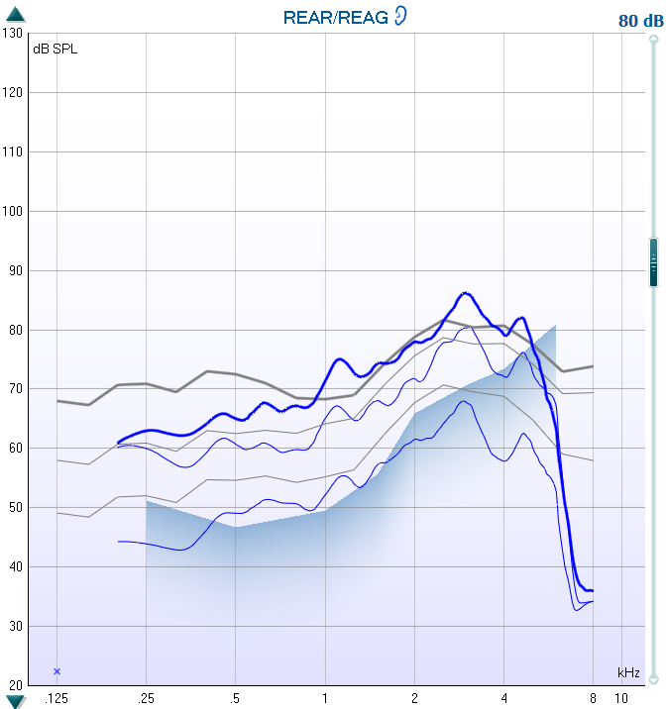
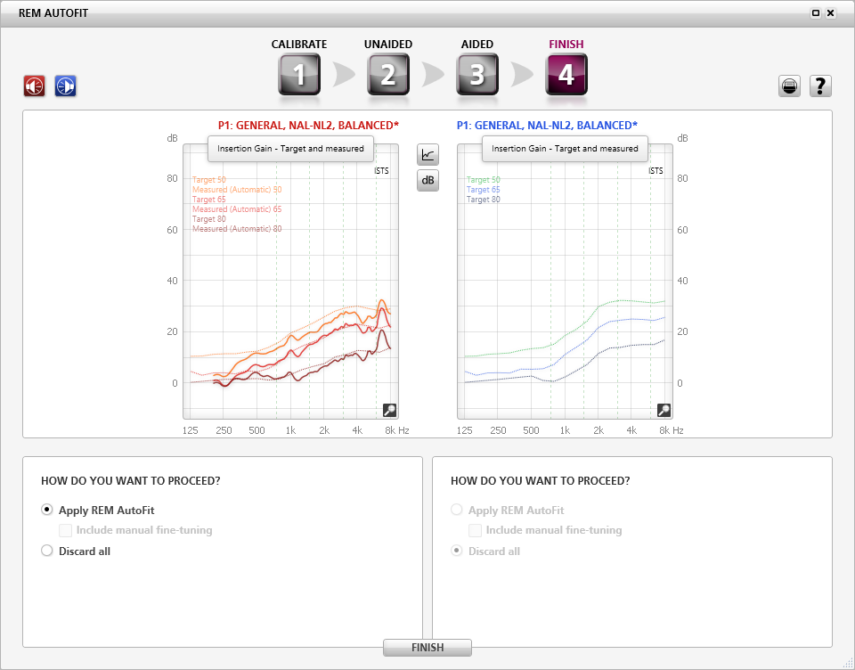
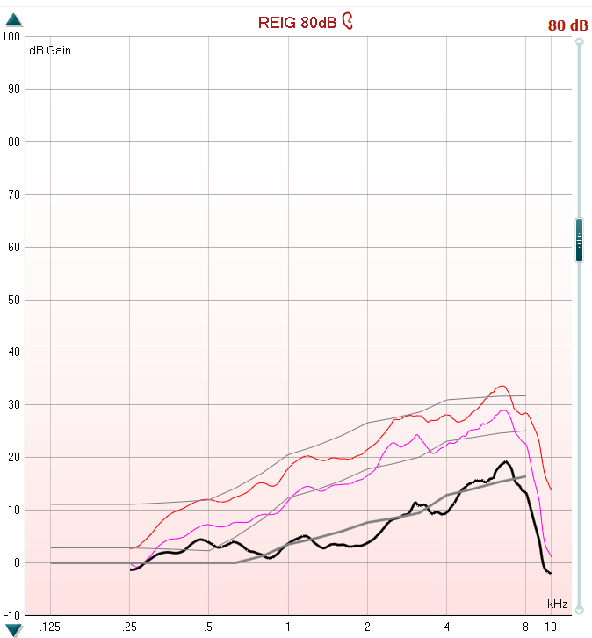
Interacoustics is IMC 2 ready
This HIMSA IMC2 regulated integration allows a faster communication between fitting software and diagnostic software to perform fitting
We have already implemented the IMC2 protocol into our software
We are ready to support all hearing aid manufacturers

Slide 22
Unique features

Slide 23
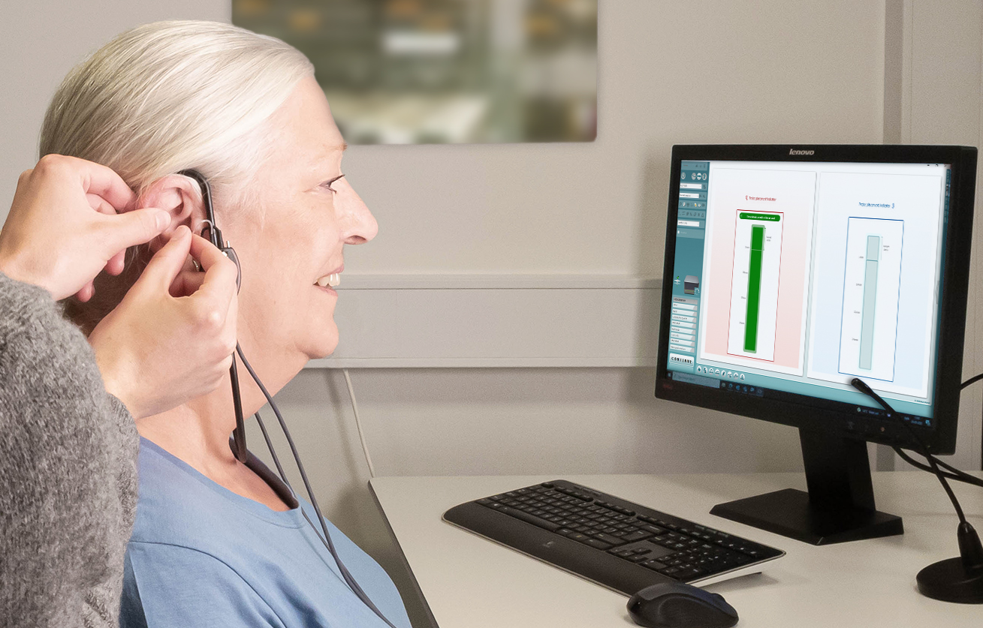
Probe Placement Indicator
The Probe Placement Indicator is an easy-to-use feature that ensures accurate and fast placement of the probe when performing real-ear measurements.
Benefits:
Makes fitting easier and faster
Provides confidence for the professional
Ensures patient safety
Makes fitting comfortable for the patient

Slide 24
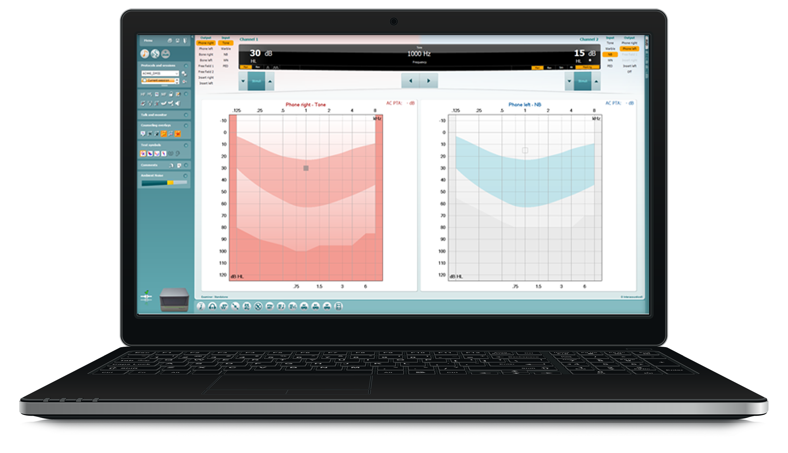
Quality Indicators
The Quality Indicators provide information about the validity of results.
The Quality Indicator feature ensures a professionals and concise way of testing your patients – regardless of the audiologist performing the test.

Slide 25
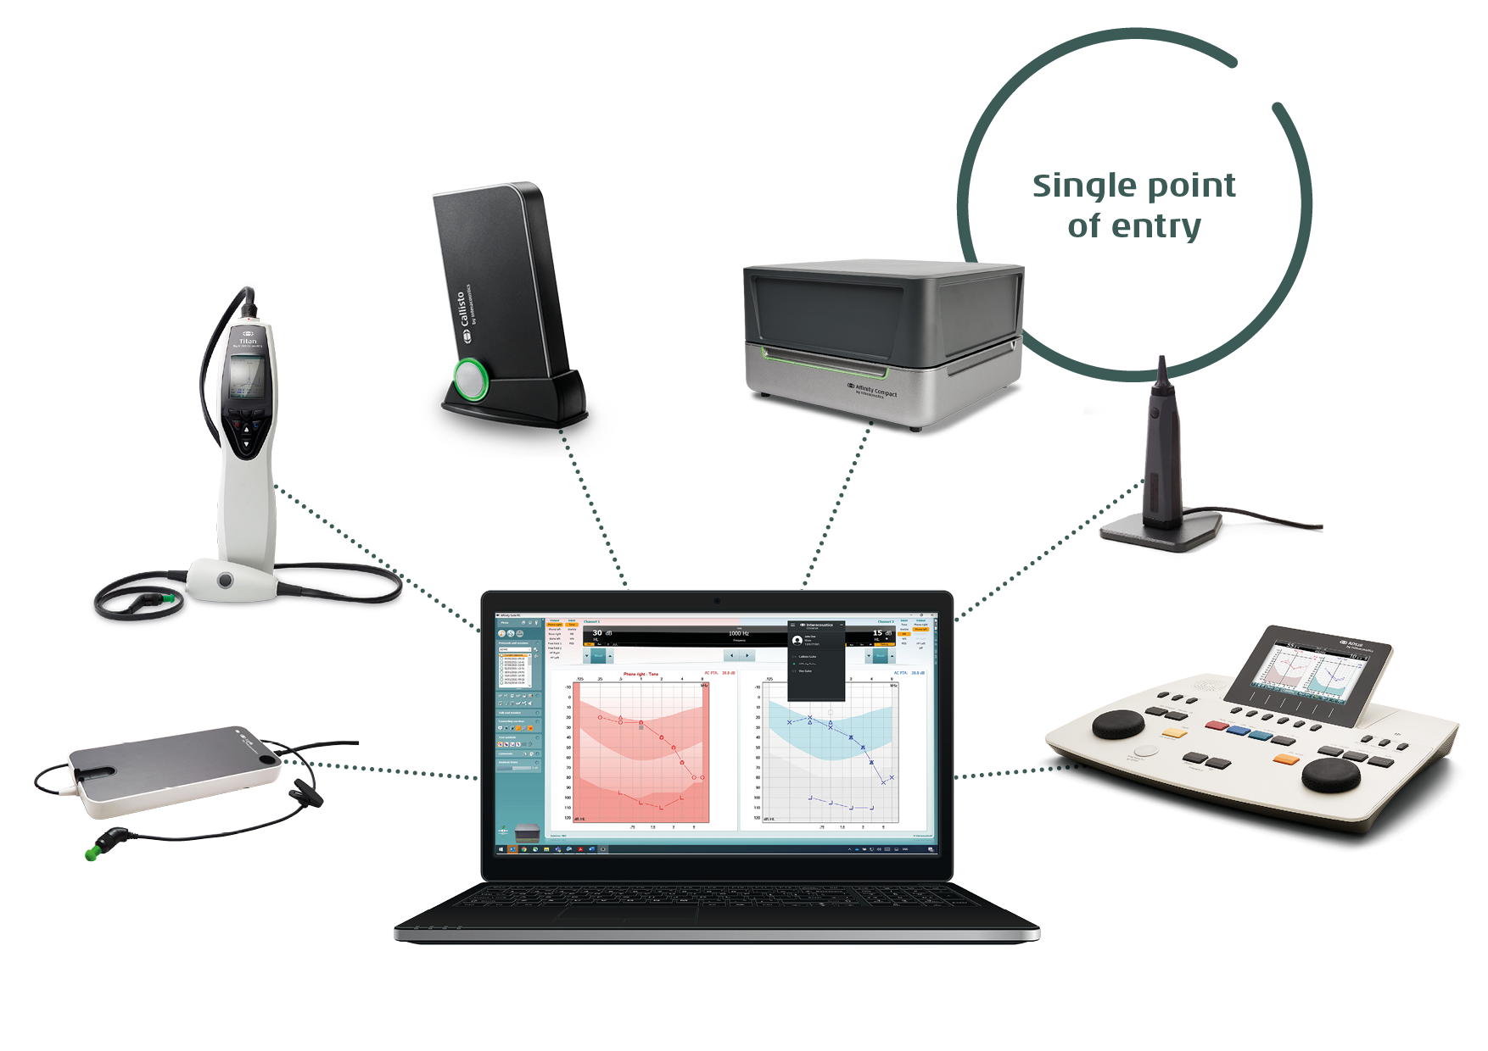
Interacoustics UniverseTM
The Interacoustics UniverseTM allows for mulitiple suites to run at the same time.
For example, you can launch the Viot™ Suite to perform video otoscopy, then quickly switch to the Titan Suite to perform tympanometry, and then back to the Affinity Suite for audiometry.
We say it’s Workflows made efficient!

Slide 26
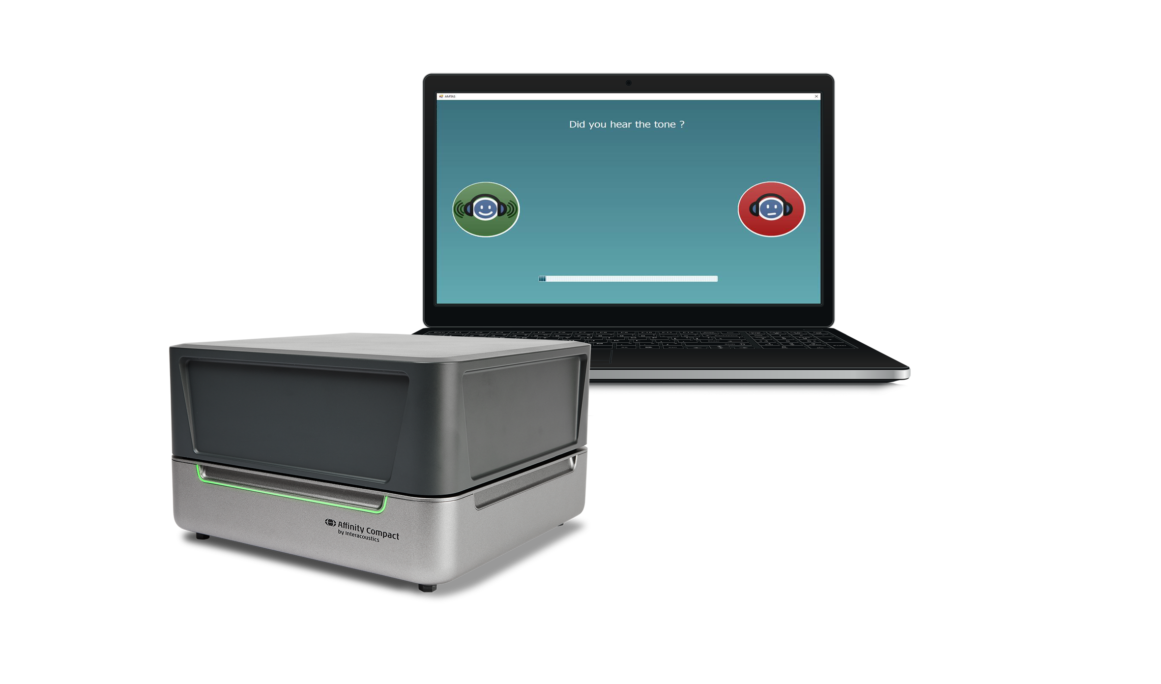
IA-AMTAS
With the IA-AMTAS automated audiometry test for Affinity Compact, clients can perform a hearing test on their own.
This frees up time for the busy clinician for other tasks.
Once the client has completed the IAAMTAS test, the clinician can access a summary report with the test data and quality indicators of the session.

Slide 27
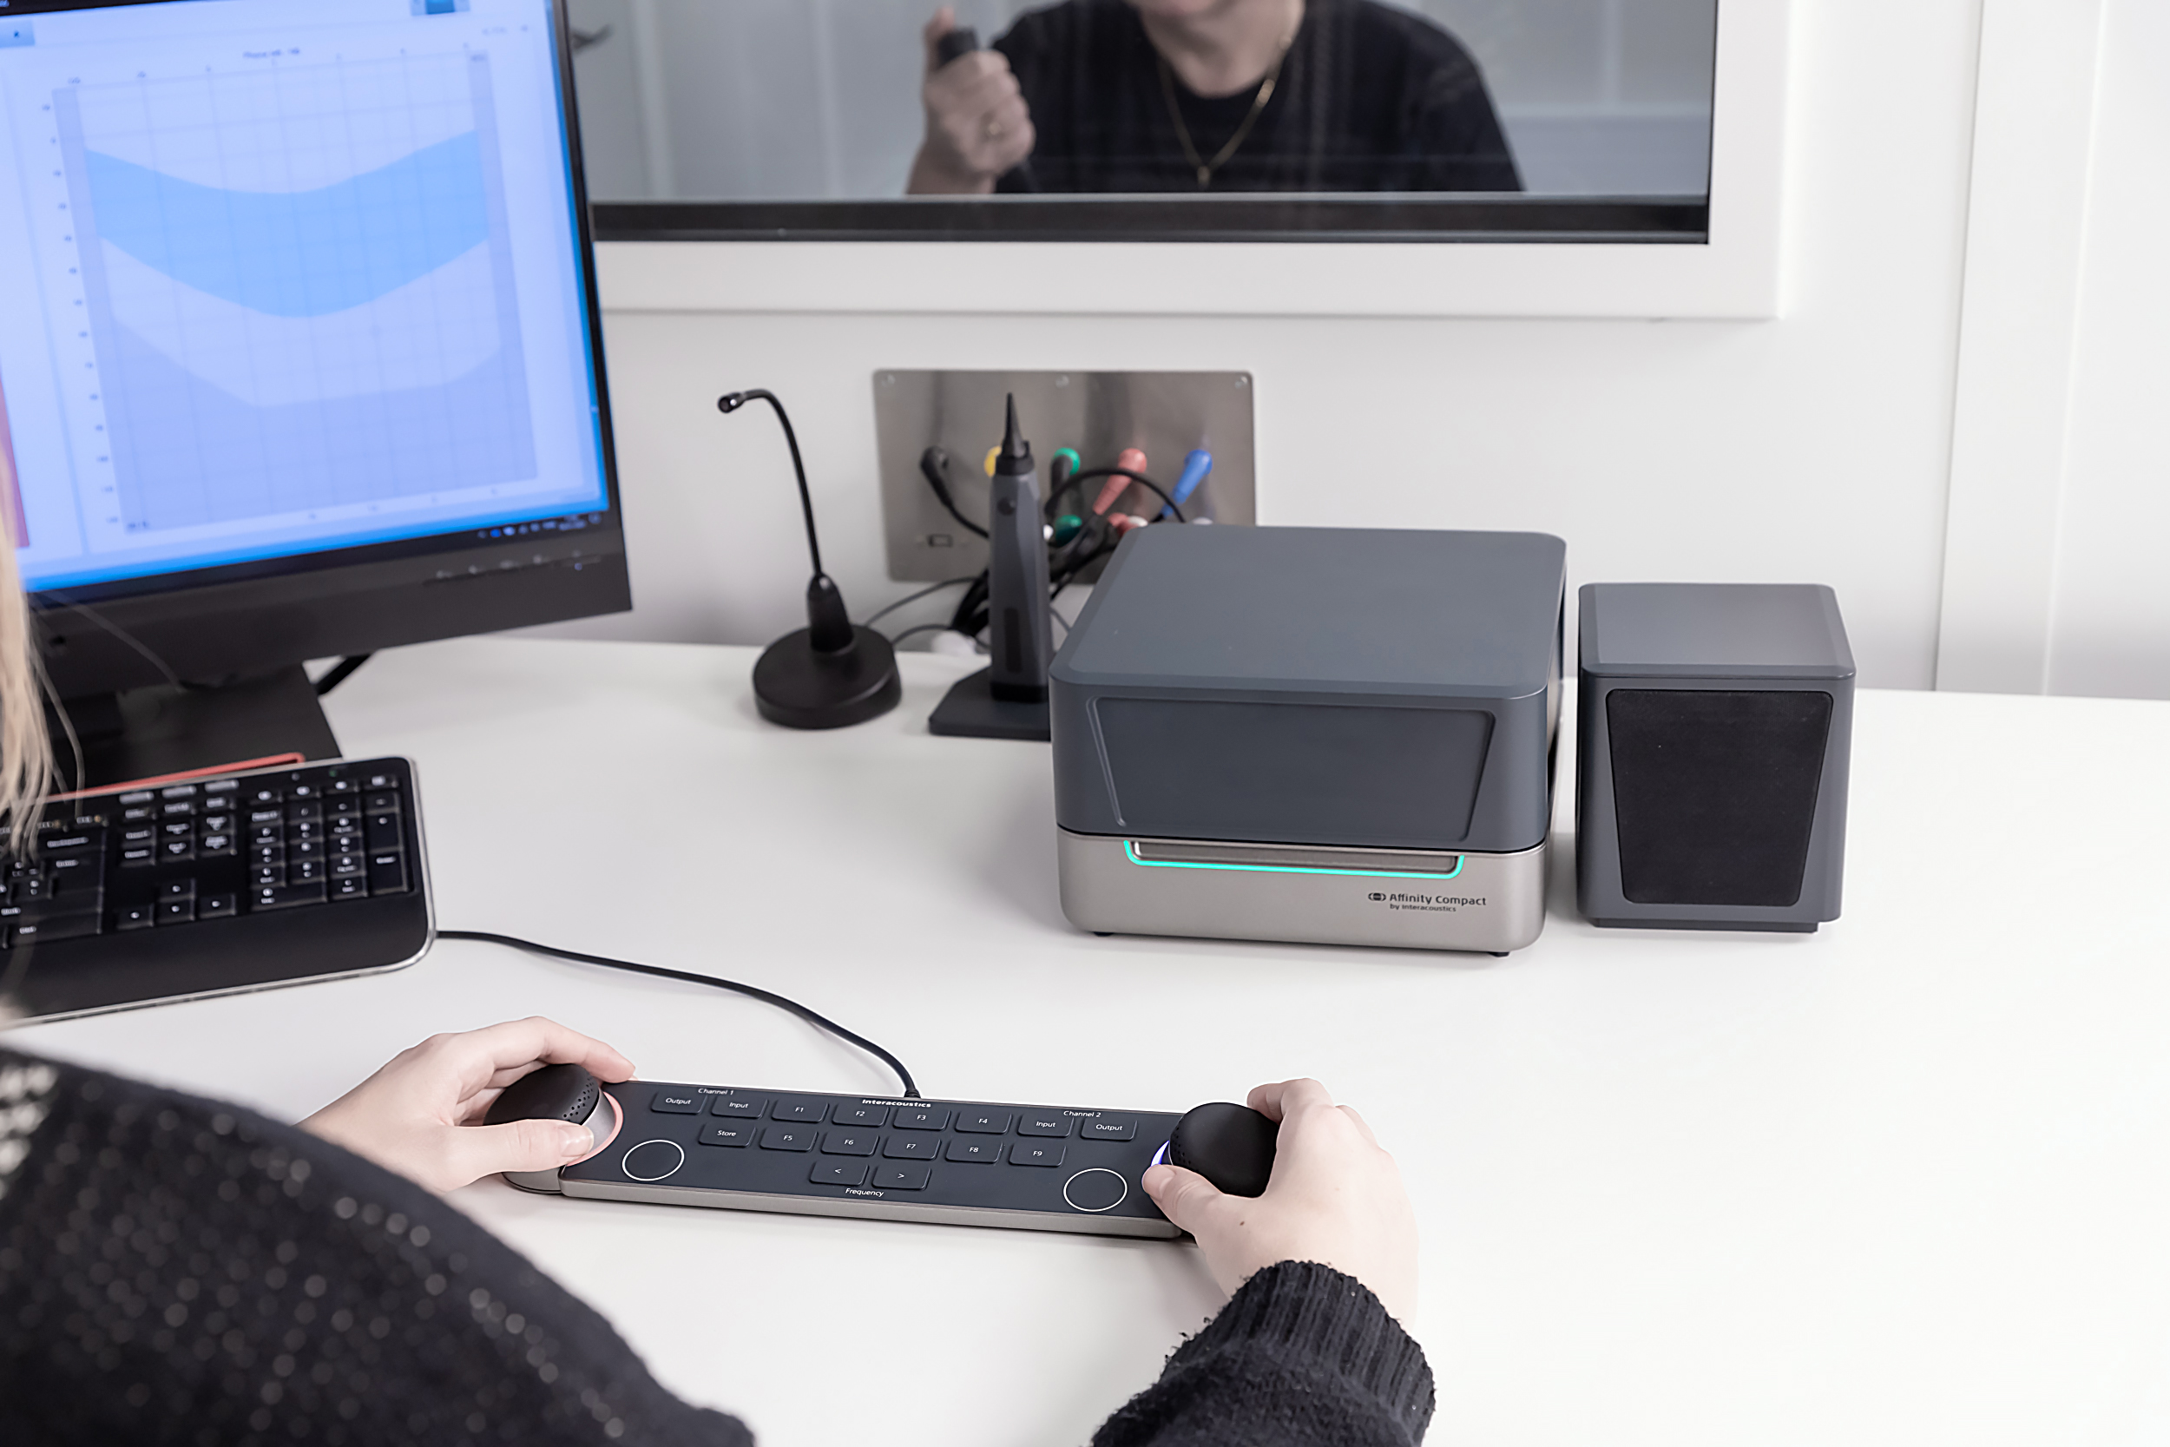
Audiometer Keyboard
Making the transition to PC-based audiometry has never been easier.
The Audiometer Keyboard combines the touch and feel of a standalone audiometer with the data security and efficiency of PC-based technology.
By pairing the Audiometer Keyboard with the Affinity Compact, you have a complete and portable package for testing when you’re on the move.

Slide 28
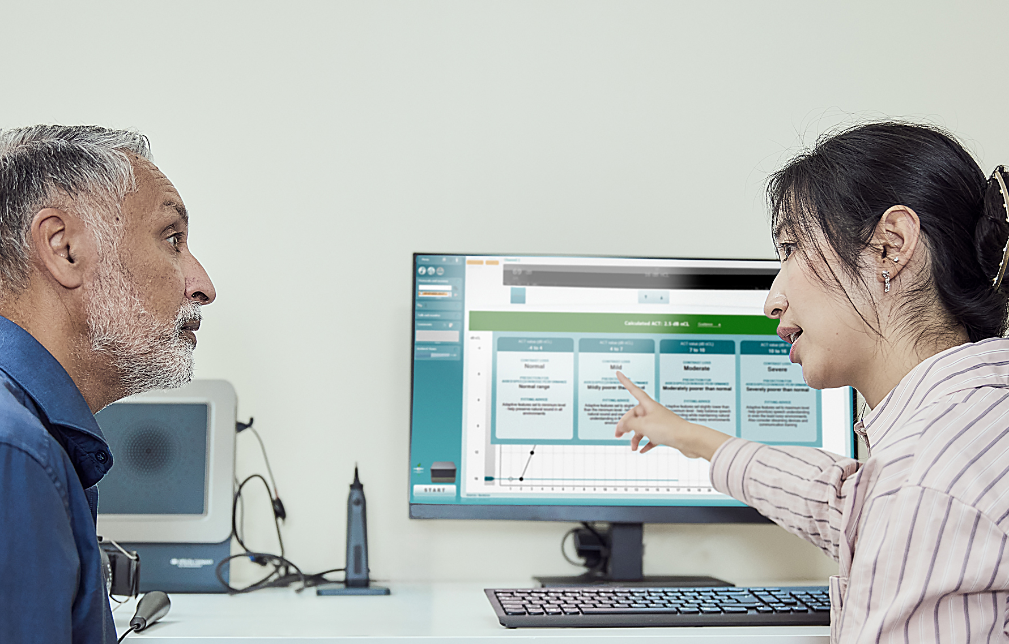
Audible Contrast Threshold (ACT™) test
Conversations made clearer
The ACT test is an above-threshold, non-language specific test that quantifies a person’s real‑world ability to hear in noise.
The test applies the shape and levels of the audiogram to ensure the correct stimulus intensity is applied.
Use the ACT value to counsel clients on how to manage their hearing-in-noise ability, including automatic prescription of adaptive features in selected hearing aids.

Slide 29

New platform
Brand new platform developed for Affinity Compact.
30% faster than Affinity 2.0 and other equipment in the market.
Speed, precision and performance to bring you to the next level and support your needs in the future.

Slide 30
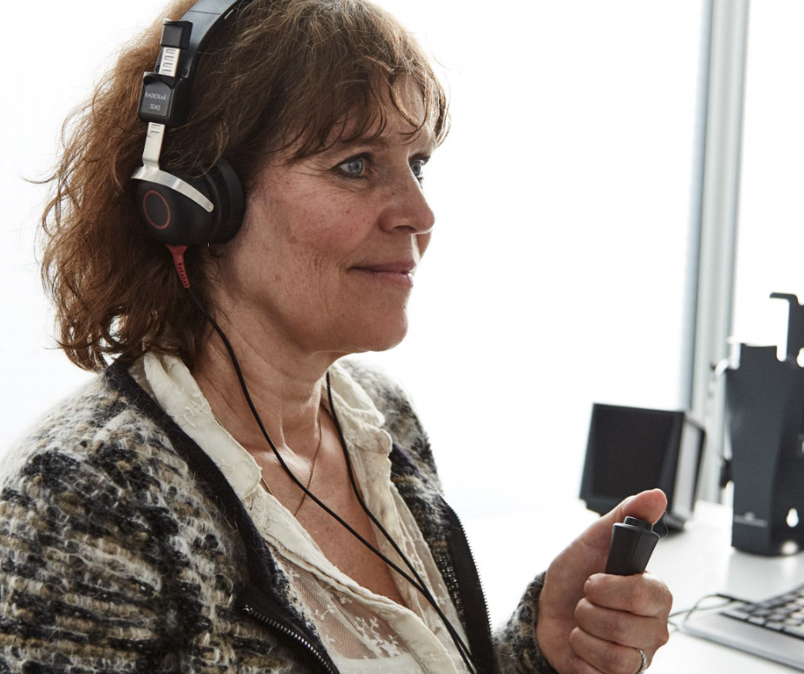
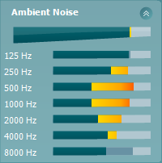
Ambient Noise
Your hearing aid fitting is only as good as your Audiometry.
…and your Audiometry is your starting point to your fitting.
Monitor the test environment during your testing to ensure the highest quality measurements.

Slide 31
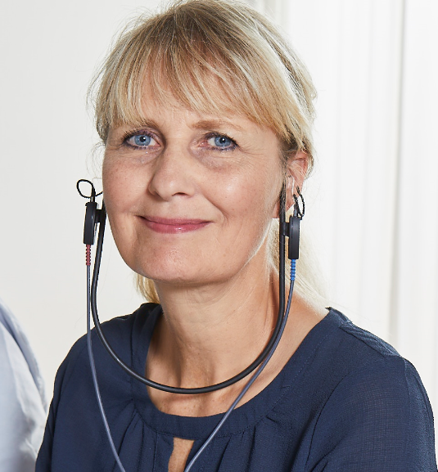
Listen to…
Listen directly to the probe microphone or the coupler microphone.
This can help you, as a clinician, to further understand the patient’s feedback.
Or it can be used to help the patient’s support to understand how the hearing aid is performing.
Listening in to the coupler microphone is powerful for parents to hear how their child’s hearing aid performs.

Slide 32
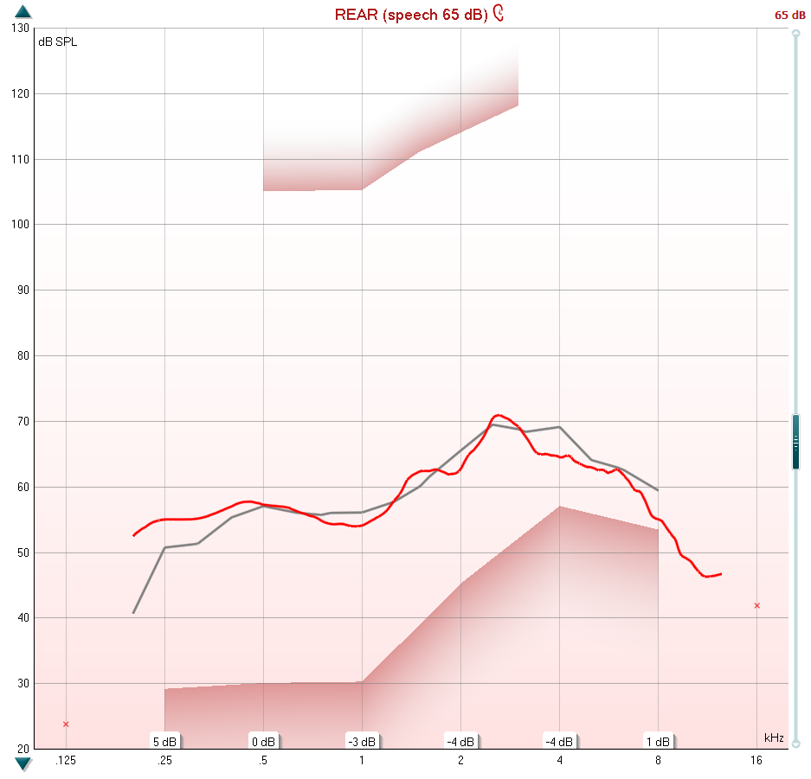
Delta Values
The system calculates the difference between your measurement curve and the target curve.
The view is maintained to give you a familiar appearance.
Allows better match to target.

Slide 33
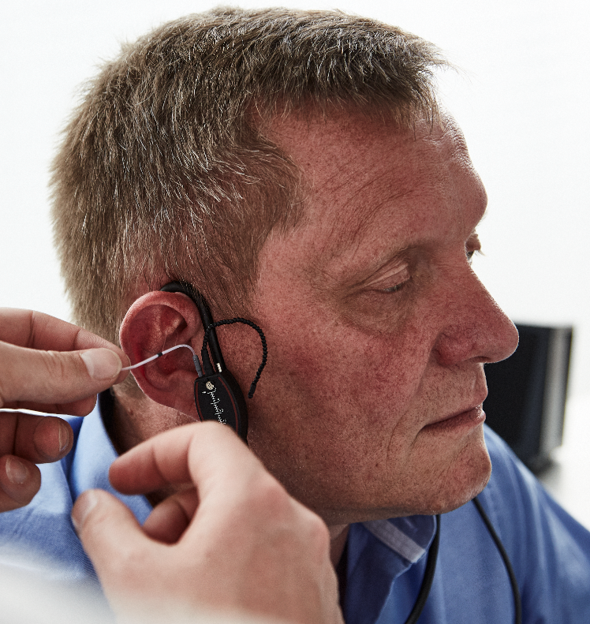
High Frequency REM/RECD
Hearing aids are amplifying up to higher frequencies, why not measure them here too?
High-frequency amplification contributes to better music appreciation and a more natural sound.
Measure up to 16 kHz via the REM headset, which brings incredible measurement quality up to 12.5 kHz.
Measure up to 16 kHz via coupler fitting.

Slide 34
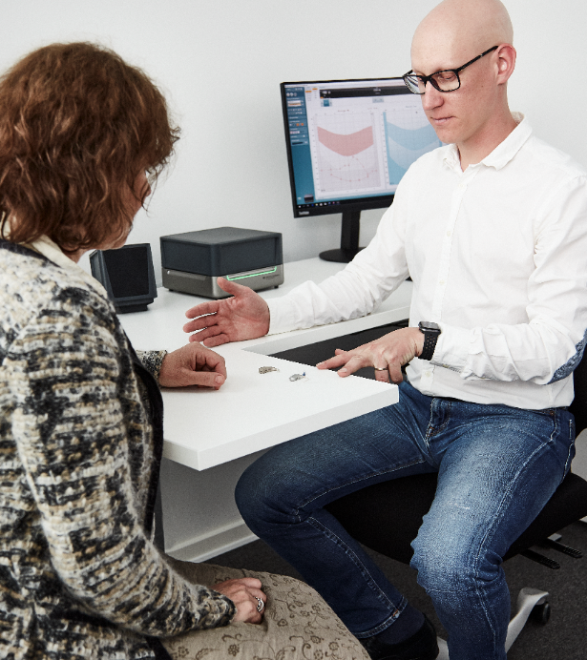
Hearing Aid Transition
Why start from scratch when seeing client who already have hearing aids?
Copy the audibility they like from their current aids whilst upgrading them to newer technology.
Beneficial when you don’t have the client’s historic sessions.
Beneficial when moving the client to a different brand of hearing aid.

Slide 35
Interacoustics.com
info@interacoustics.com
(+45) 6371 3555

